Slide 1
An NSS Audio-Visual
Library Presentation
Caves: A Unique and Fragile Environment
(1993)
S205 64 Slides 1/25/2021

Slide 2
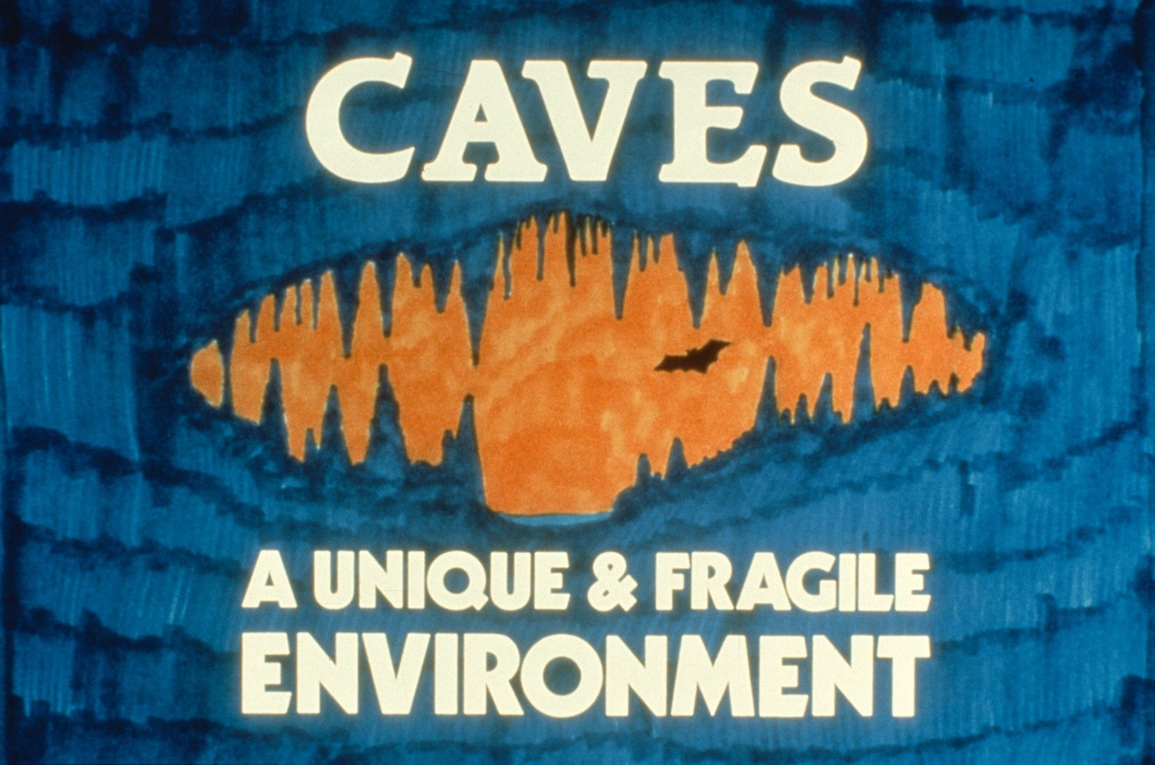

Slide 3
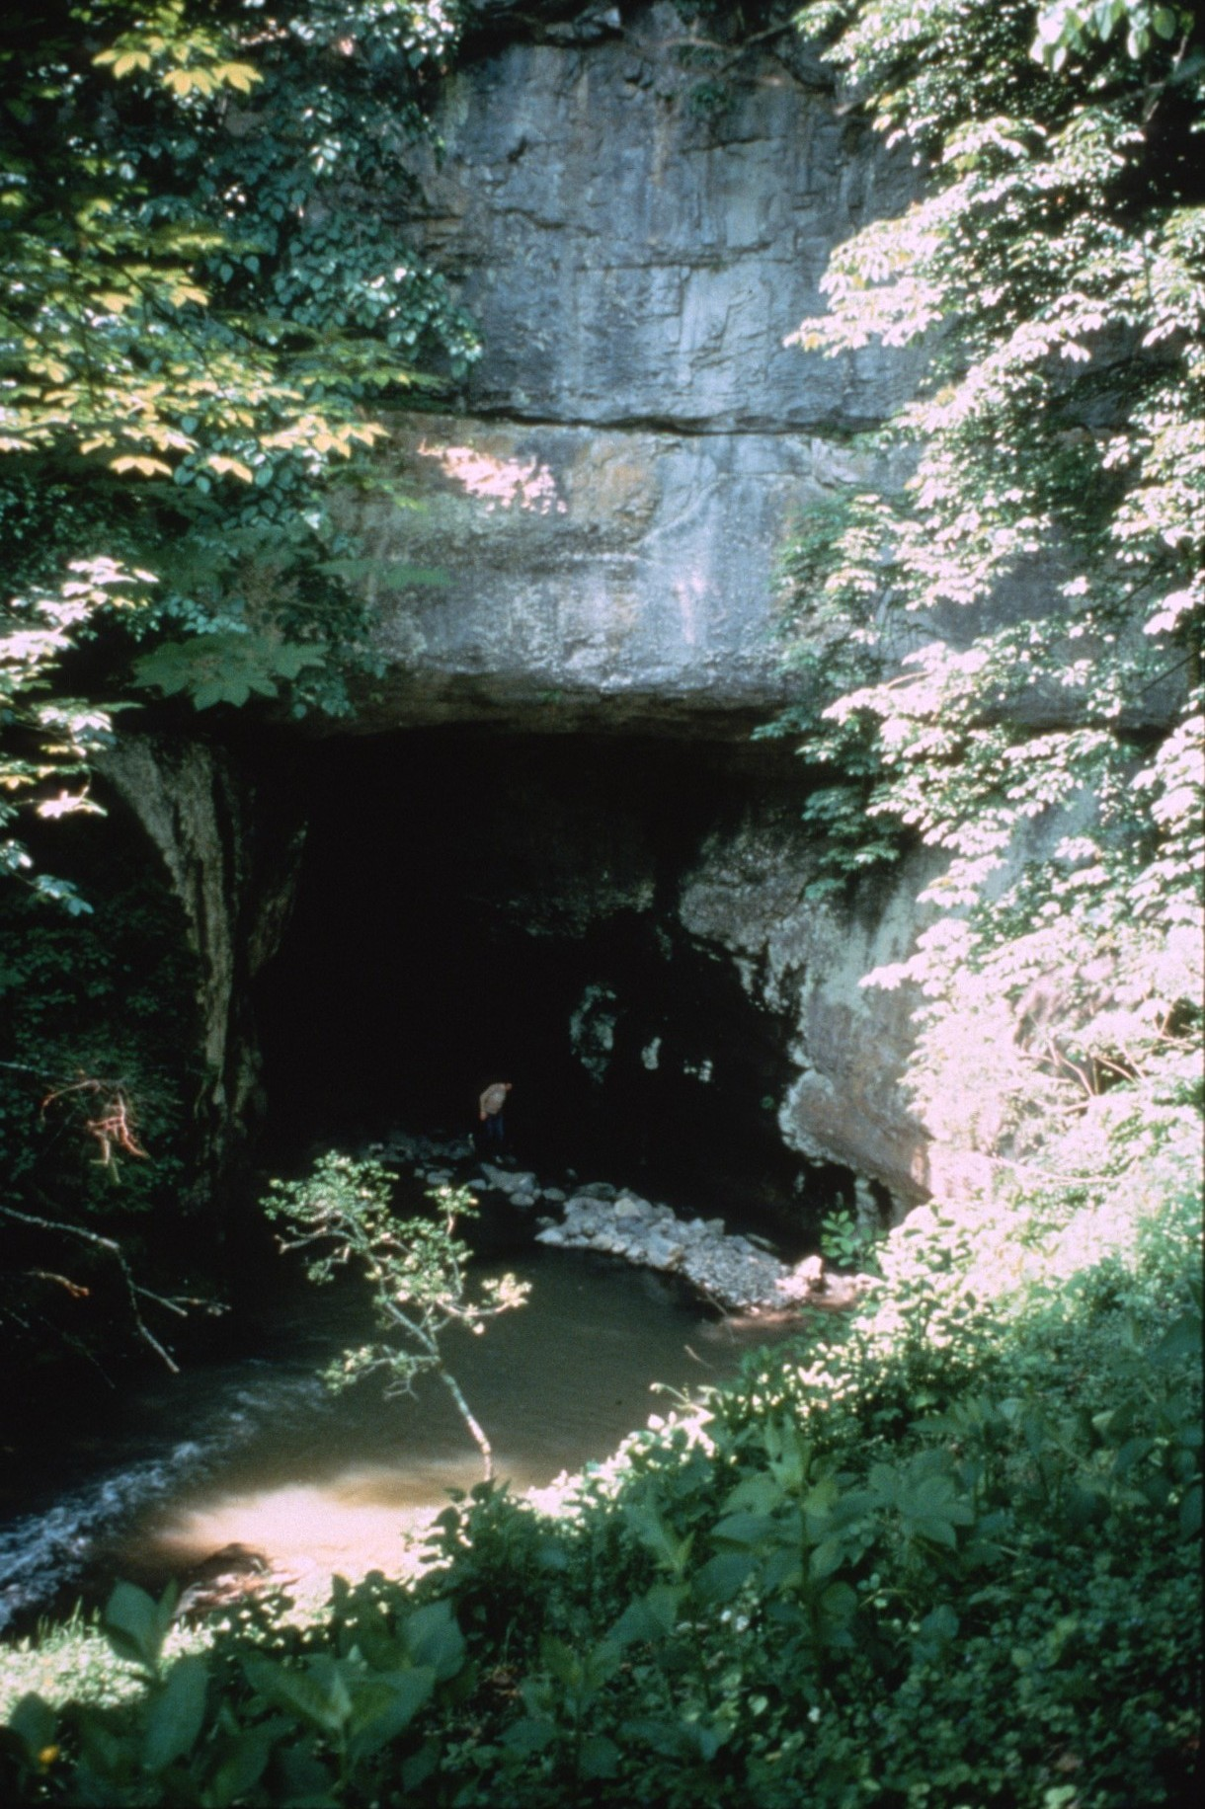
Notes:
Caves… (Greenville Saltpetre Cave, WV, 1978 photo by Paul & Lee Stevens)

Slide 4
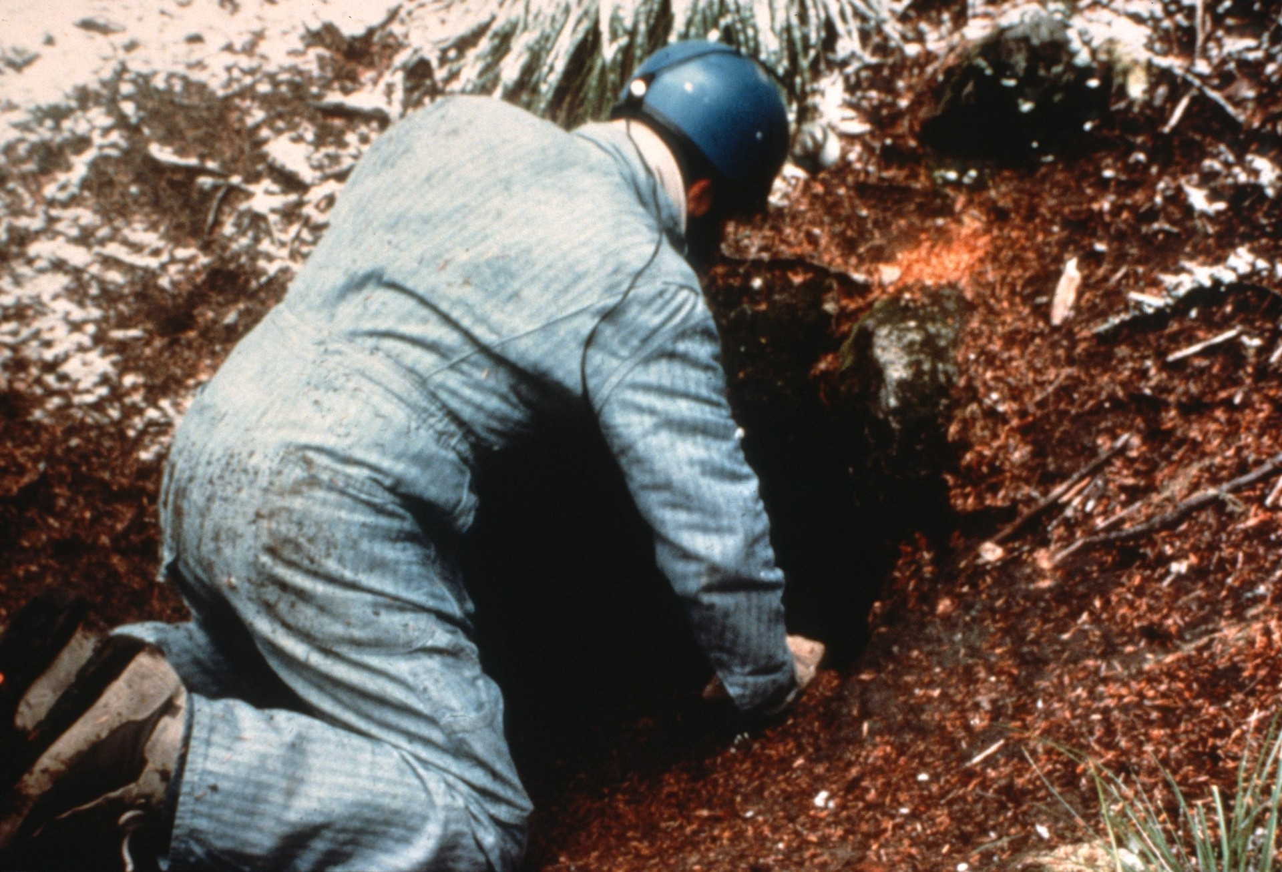
Notes:
They can be found in almost every part of the United States and in almost every country in the world. (Horsethief Lava Tube, WA, 1986 photo by Paul & Lee Stevens)

Slide 5
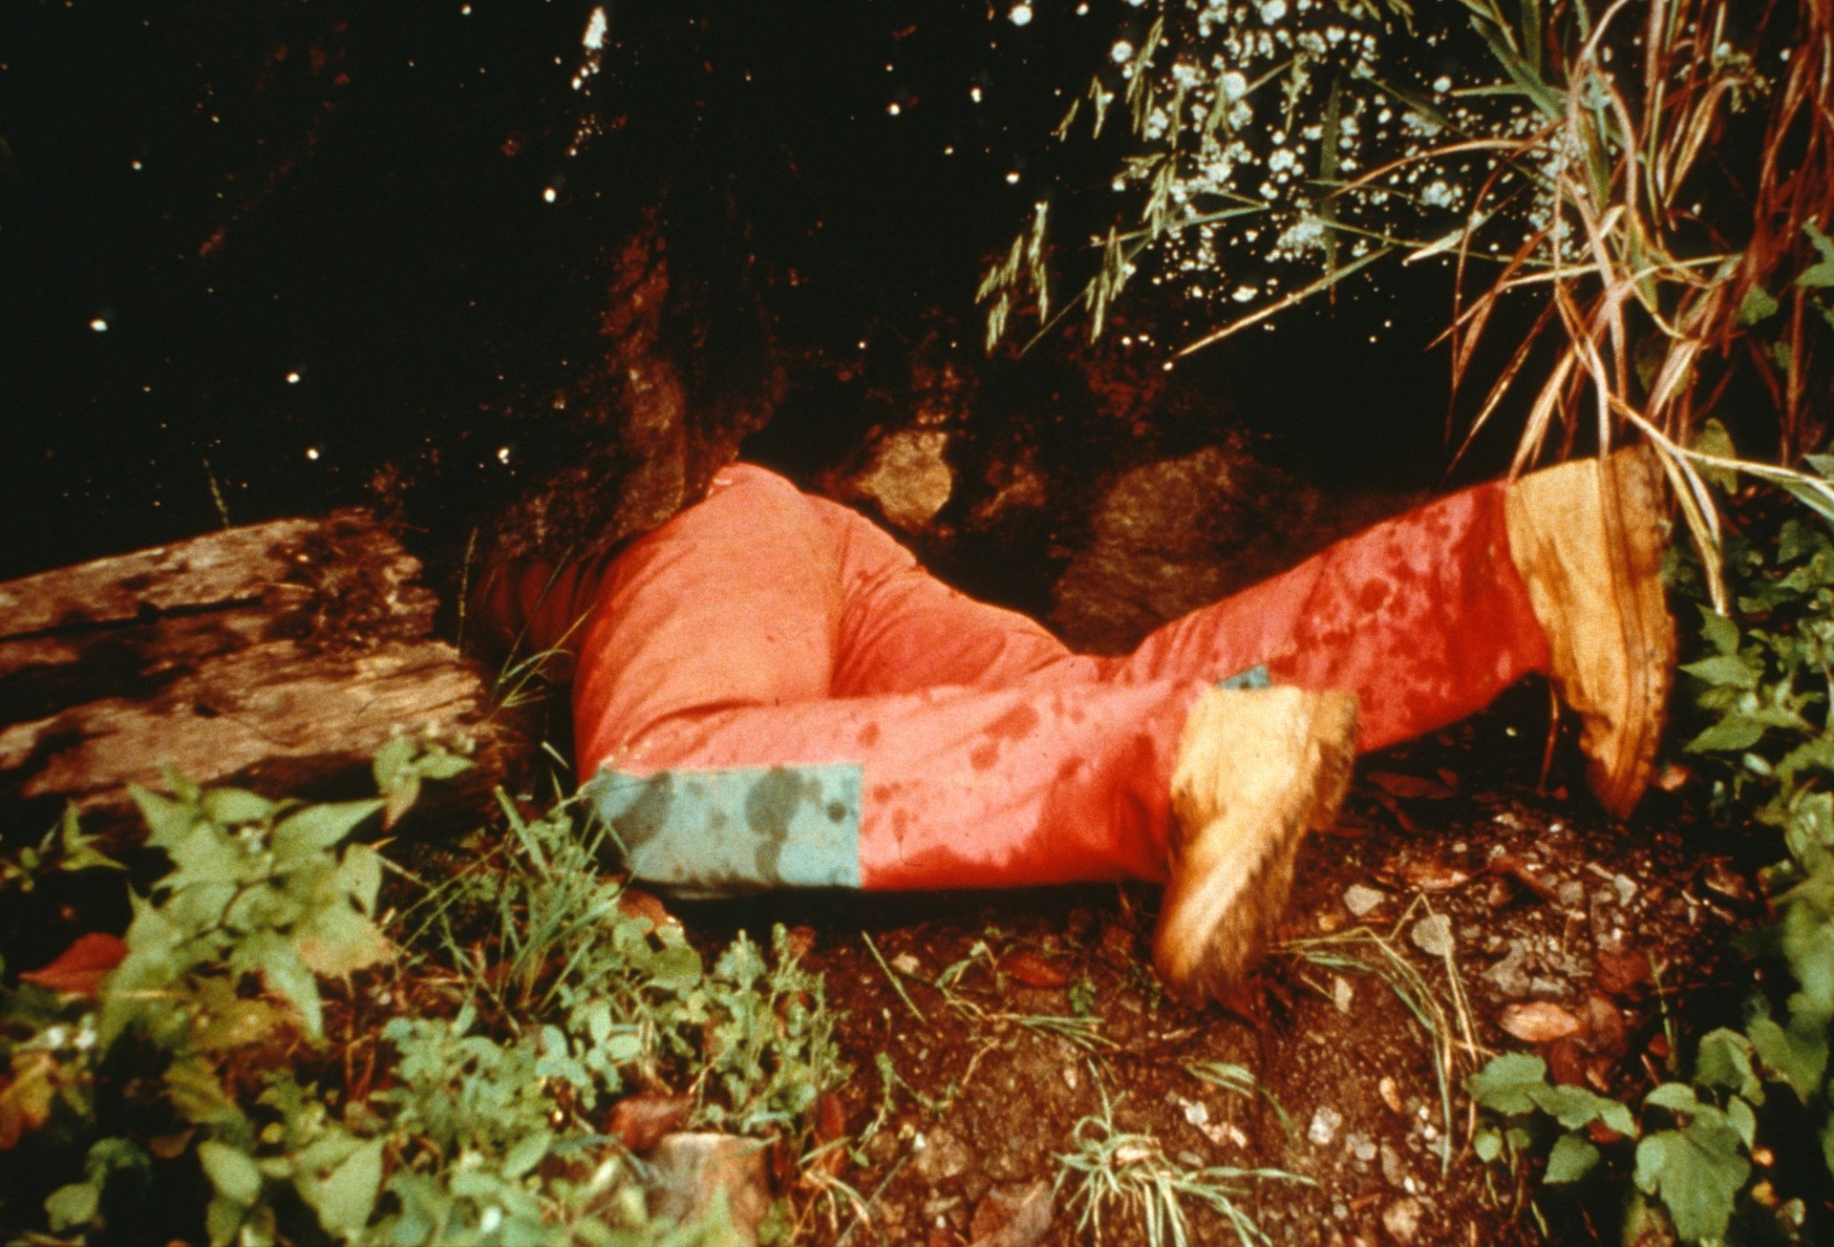
Notes:
But not many people know what caves contain or how they affect the people who live around them. (Locomotive Breath Cave, VA, 1989 photo by Paul & Lee Stevens)

Slide 6
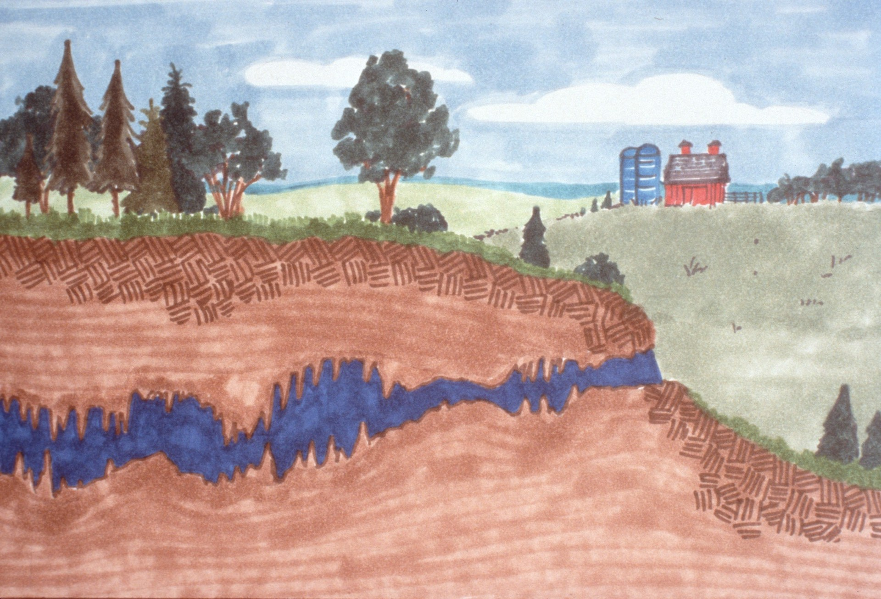
Notes:
Caves are voids in the Earth’s crust which are created by natural processes. They differ from mines because they have not been dug by humans.

Slide 7
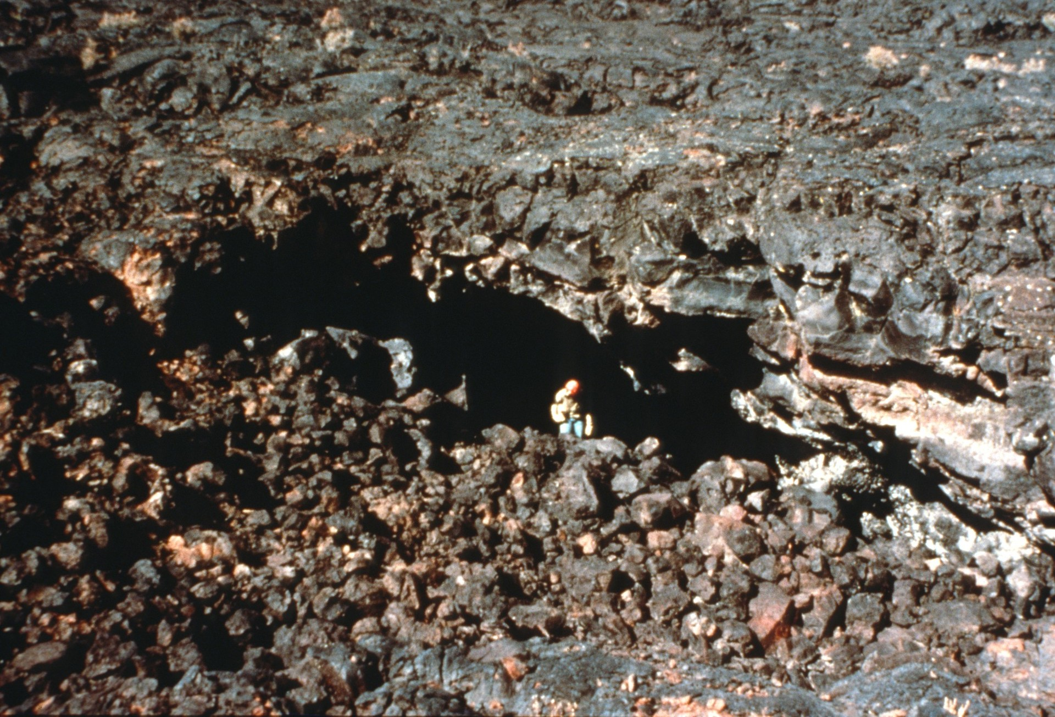
Notes:
While some caves in volcanic areas are created in cooling lava…

Slide 8
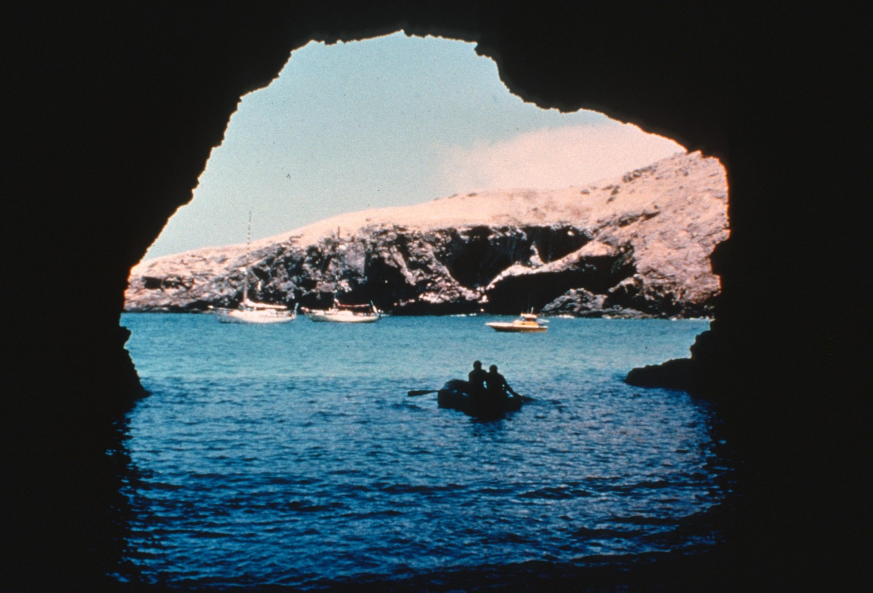
Notes:
…and some result from the erosion of waves pounding against the sea coast,… (Photo by Dave Bunnell)

Slide 9
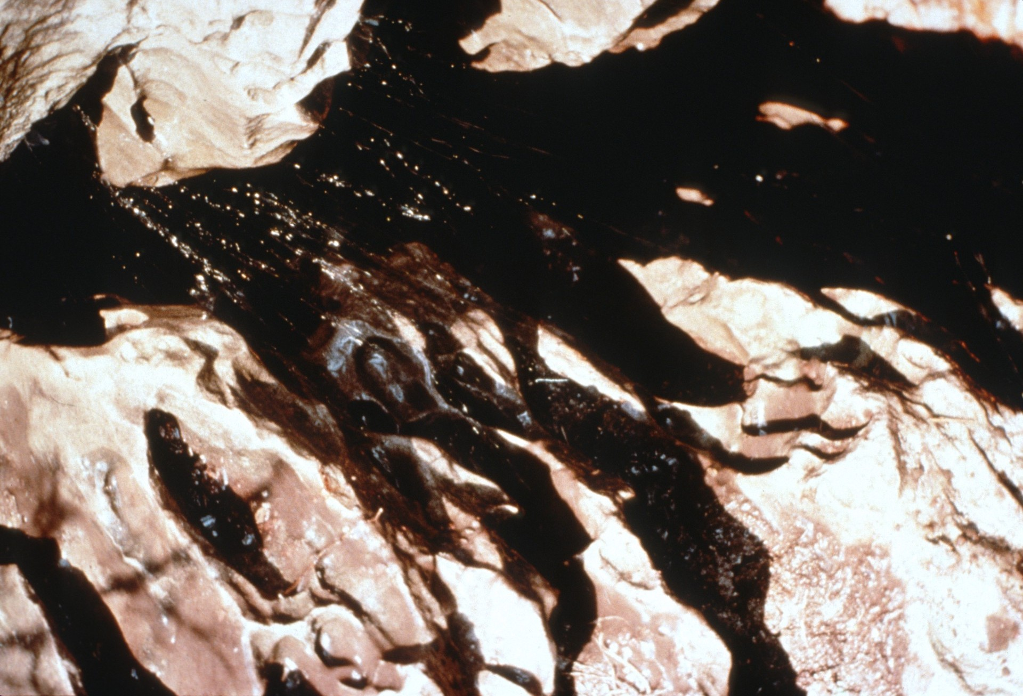
Notes:
…most are formed by water seeping through cracks and eroding away the surrounding rocks.

Slide 10
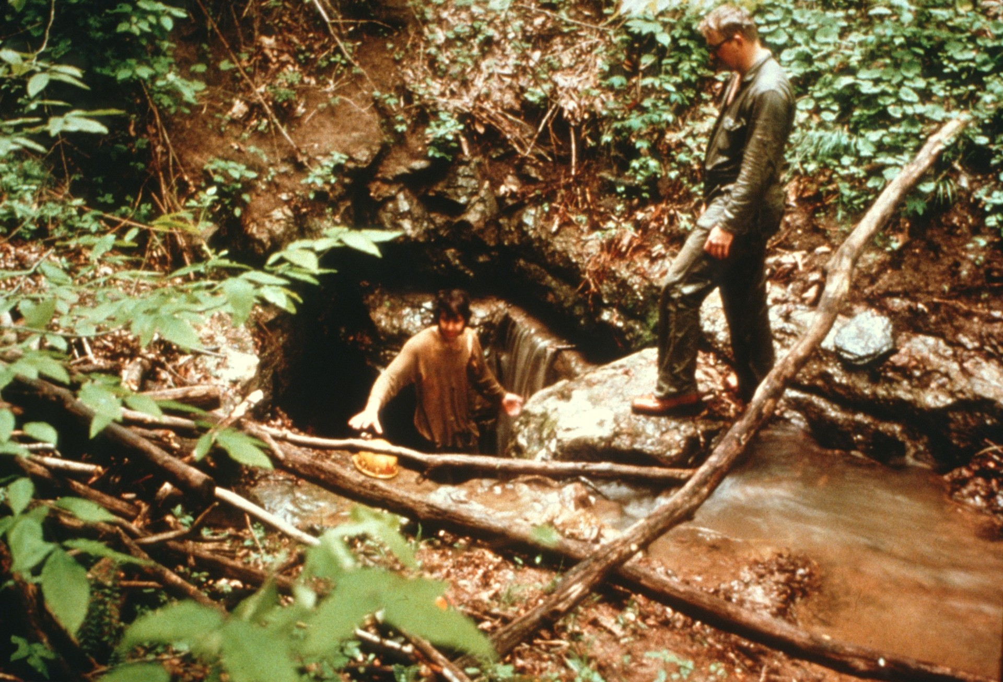
Notes:
In some cases surface streams will find these cracks in the rock and move through them, eroding the rock even further. When openings in the rock become large enough, the entire stream may change its course and flow underground through the cave. (Jones Cave, WV, 1975 photo by Paul Stevens)

Slide 11
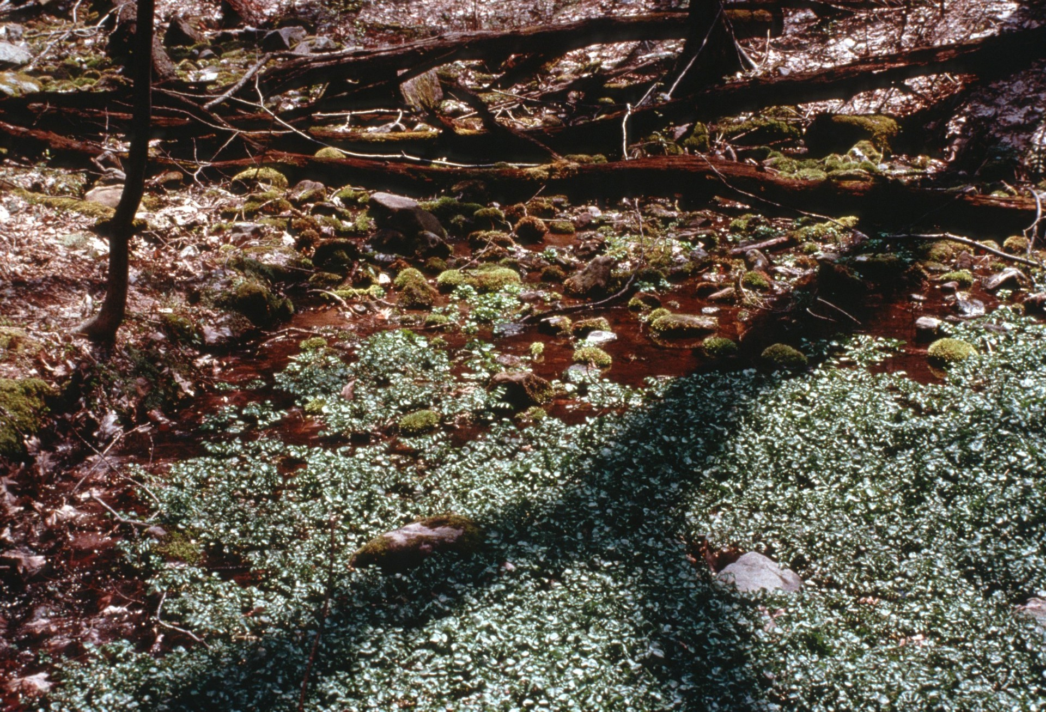
Notes:
When these underground streams again reach the surface, they often create springs.

Slide 12
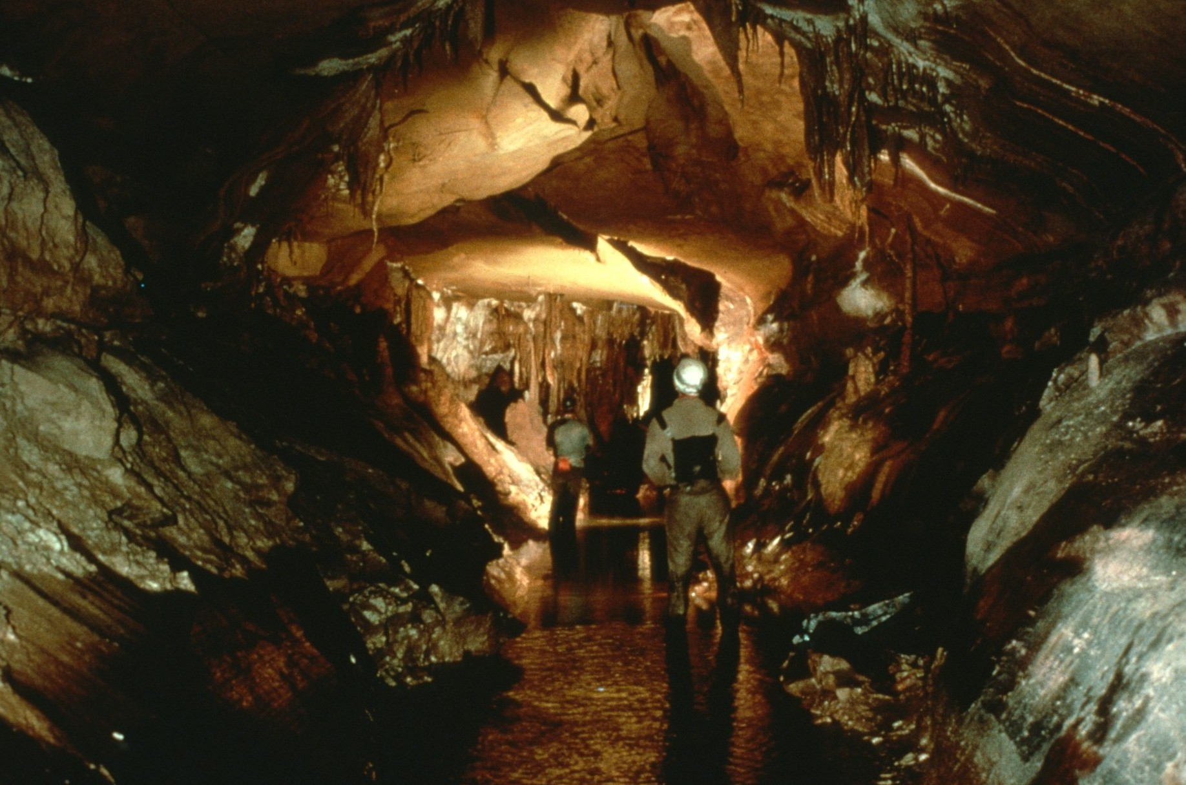
Notes:
Eventually huge chambers and passages can be formed by this process of water moving through bedrock. (Photo by Ed McCarthy and Carl Samples)

Slide 13
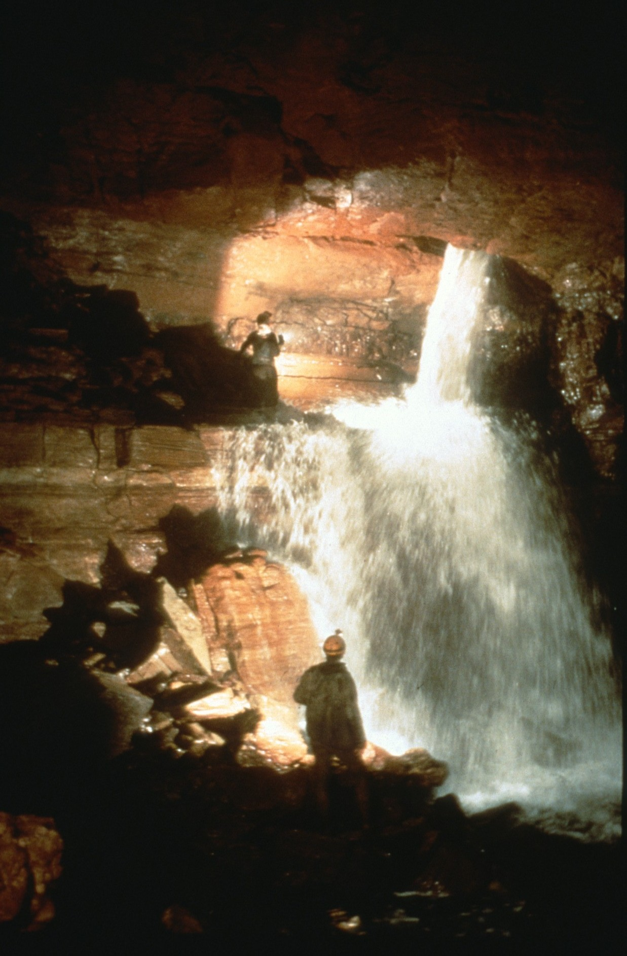
Notes:
Water is one of the major way nutrients enter a cave. These provide food for the animals which have learned to survive in a cave. (Photo by William Storage)

Slide 14
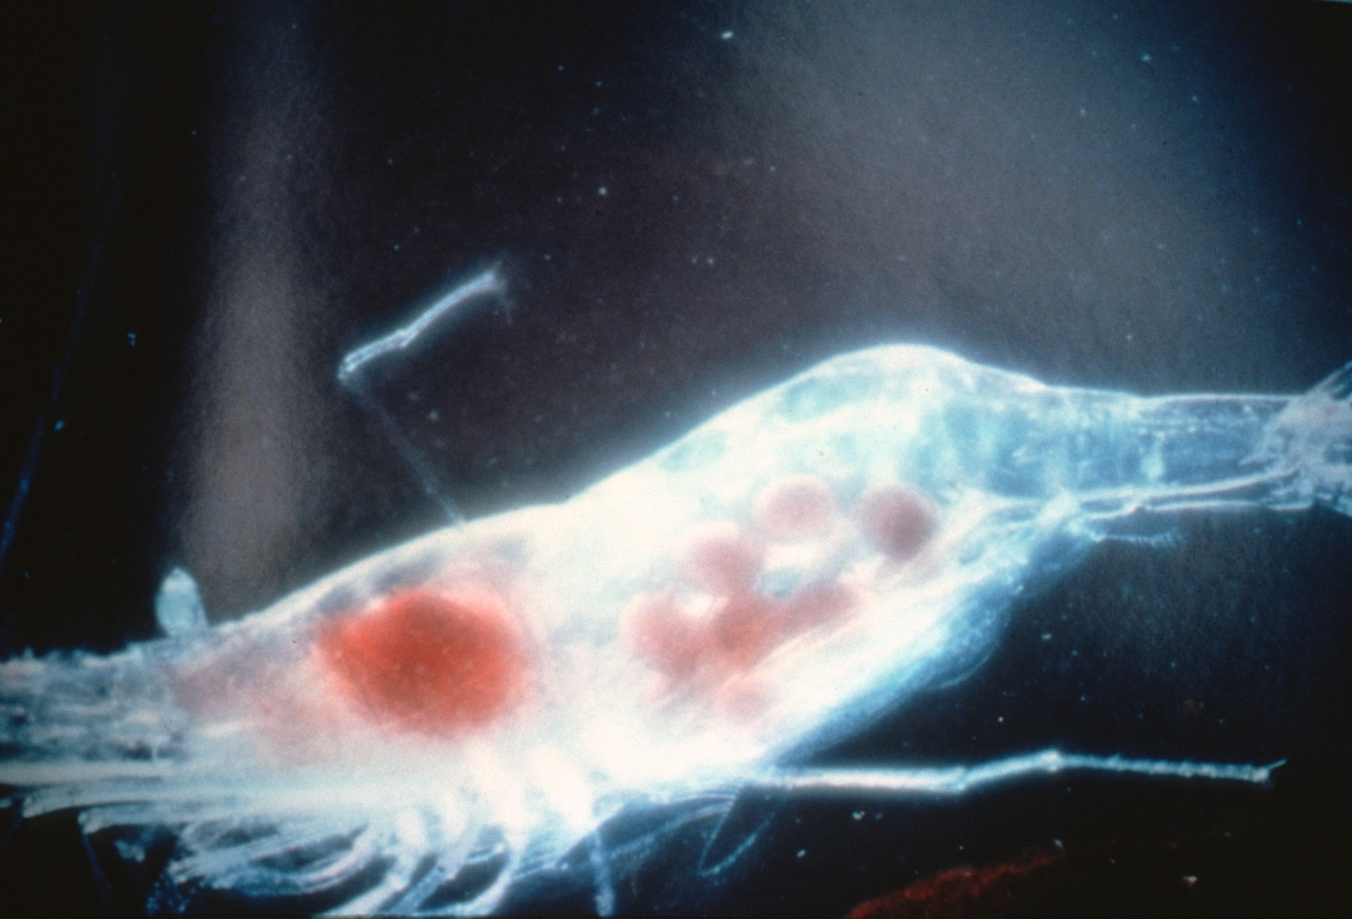
Notes:
Animals which live their entire lives in caves have evolved to survive in the demanding cave environment. This cave shrimp which is found in Kentucky shows some of the ways cave animals have adapted. Because caves are always dark, cave animals do not need pigment in their skin to protect them from the sun. Their skin has become so transparent that you can see their internal organs. (Photo by Horton Hobbs, III)

Slide 15
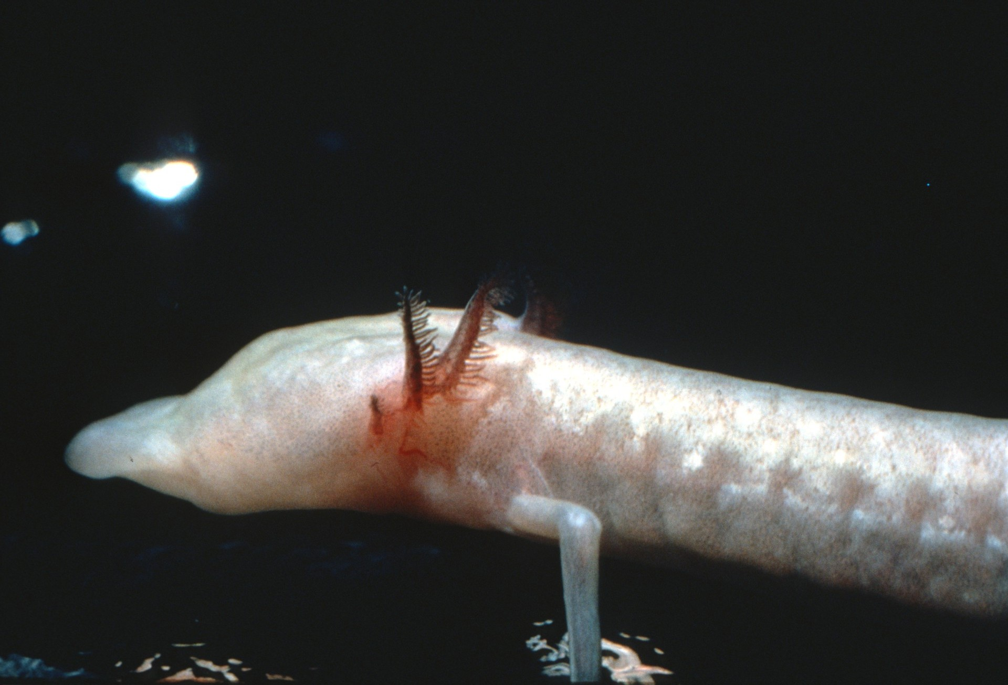
Notes:
Also, because of the lack of light, cave animals have no use for eyes and depend on smell and touch to move around and find their food.

Slide 16
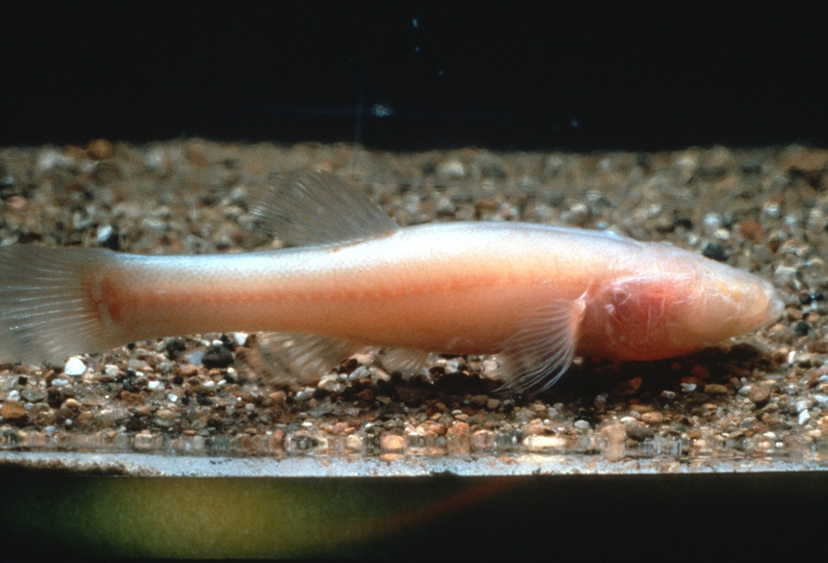
Notes:
Cave animals like this fish cannot survive outside of their cave. Without eyes and without pigment to protect them from the sun, they would soon die. These animals depend on the small area where they can survive in caves. Because they have adapted to the environment in their cave and have no interaction with others of their kind in other caves, species unique to very limited areas have evolved. Many of these species are recognized as endangered be federal or state governments or have been nominated for the Endangered Species List.

Slide 17
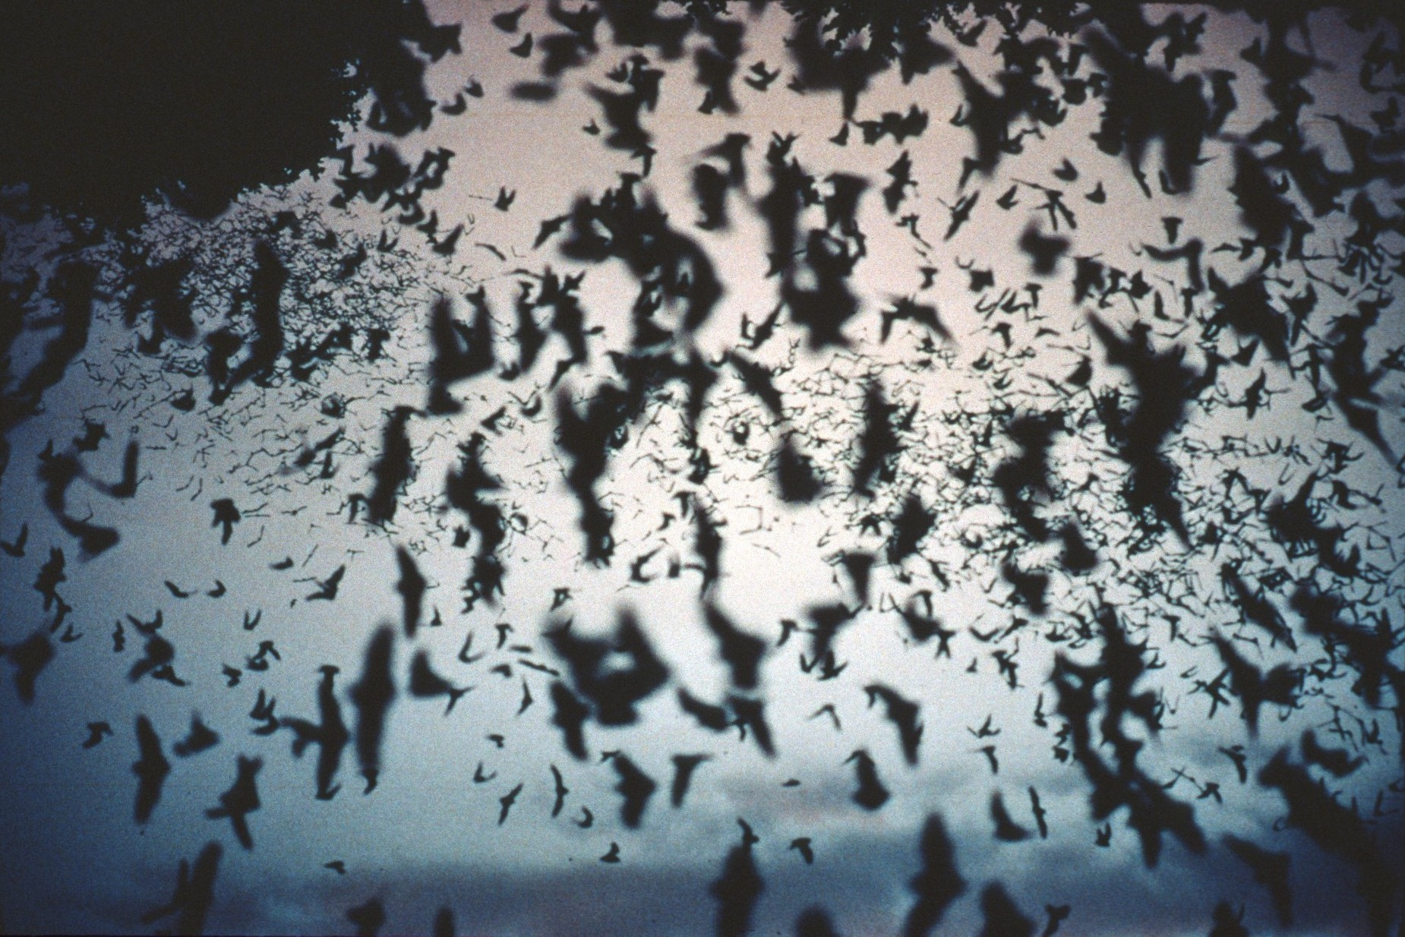
Notes:
Other species also depend on caves for their existence. (Bracken Cave, TX, 1978 photo by Paul Stevens)

Slide 18
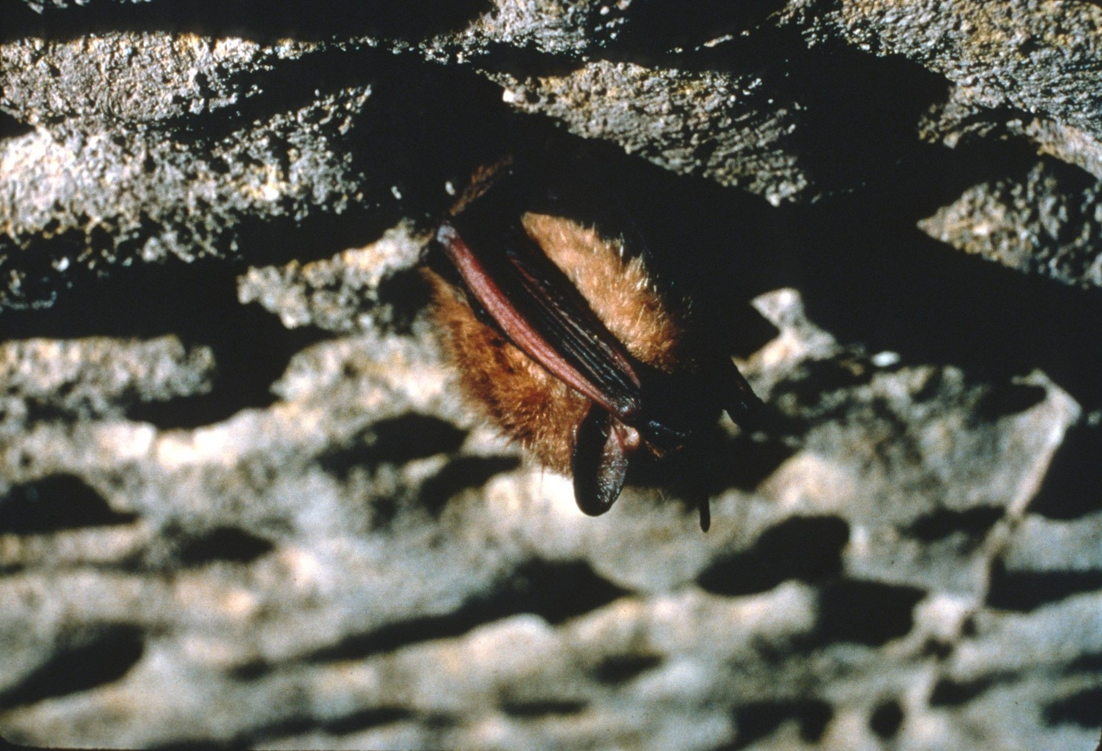
Notes:
None of the bats in the United States live on human or animal blood. Some of them eat their own weight in insects every night and help to reduce populations of moths, flies, and mosquitoes. Other bat species live on nectar like bees and are responsible for pollinating plants like the Giant Saguaro cactus in Arizona. (Photo by Chip Clark)

Slide 19
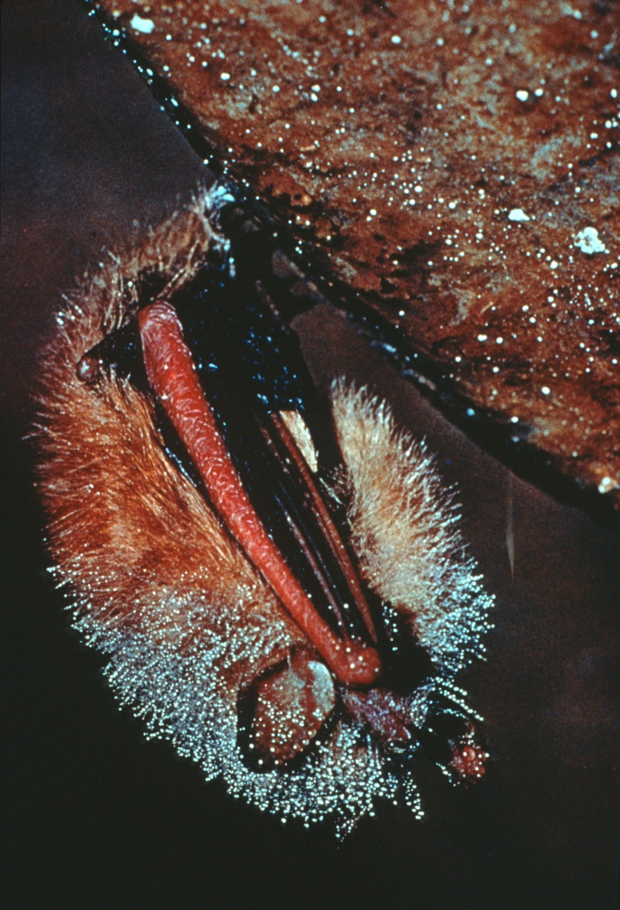
Notes:
A number of species of bats use caves to hibernate through the winter or to raise their young in summer. The nutrients they bring into those caves through their droppings are important sources of food for the animals which spend their entire lives in caves. Bat droppings, called “guano,” are an important source of natural fertilizer used by many farmers. (Photo by Charles E. Mohr)

Slide 20
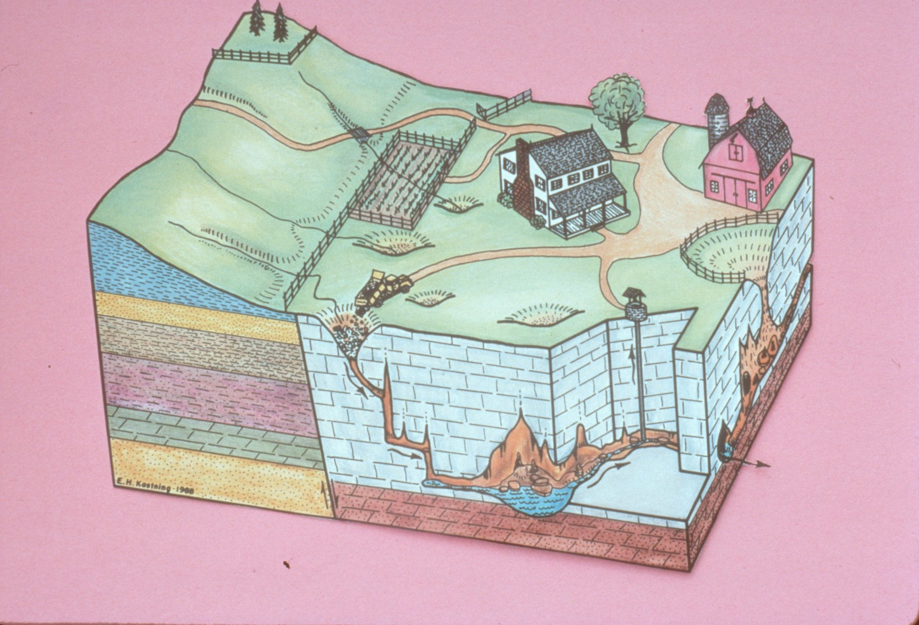
Notes:
The water that flows into caves must remain unpolluted for cave animals to survive, but clean water is important for people, too. (Drawing by Ernst Kastning)

Slide 21
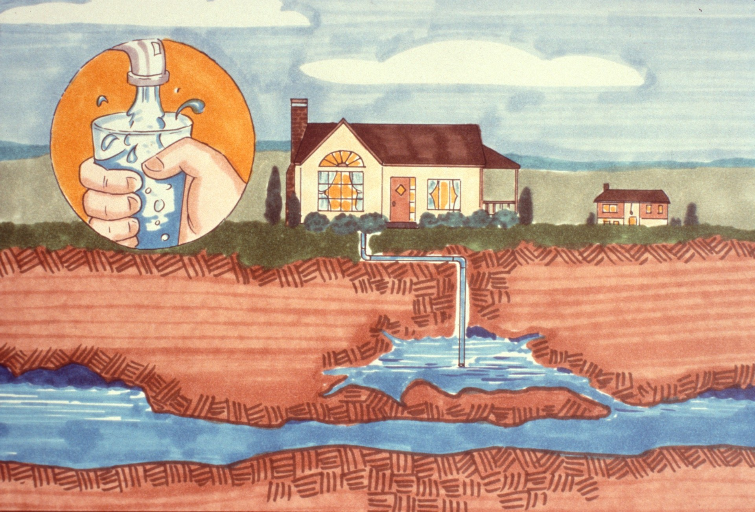
Notes:
In a number of rural communities the residents depend on underground streams for their water supply. Unfortunately, many of these people do not realize that the pits and other holes on their property may be directly connected to the underground streams where they get their drinking water.

Slide 22
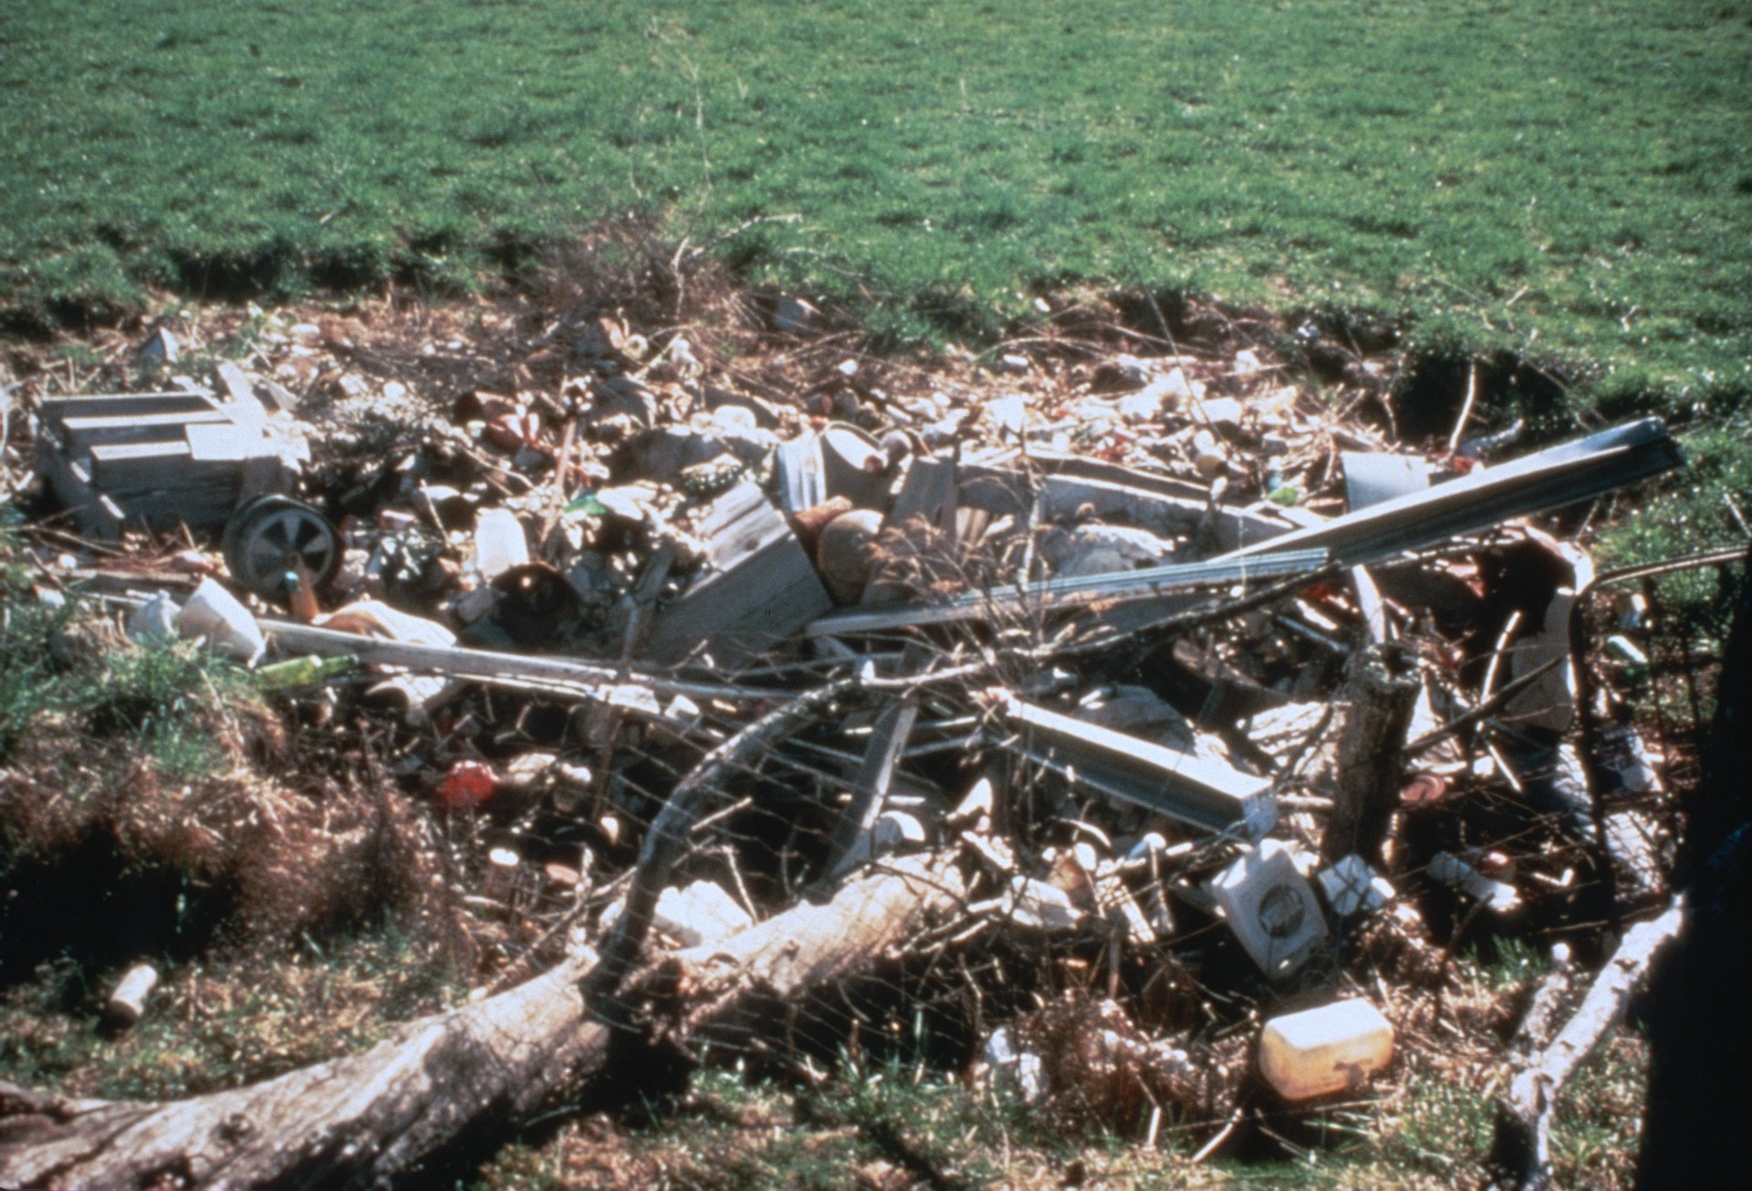
Notes:
It’s not uncommon to find people throwing their trash, garbage, and even dead animals into the entrances of caves. (Sinkhole at Organ Cave, WV, 1984 photo by Paul Stevens)

Slide 23
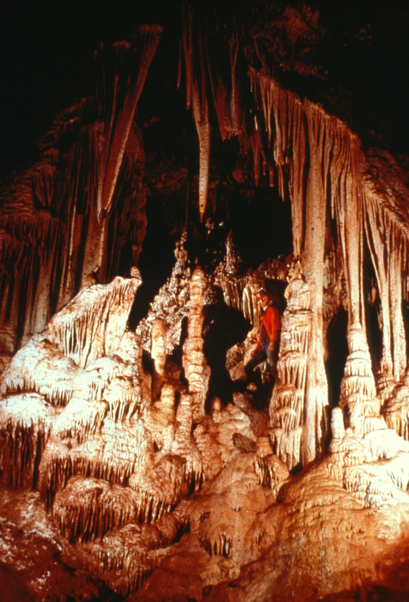
Notes:
Unique animal species are not the only thing which can be found in caves. Water which seeps through cracks in rocks becomes saturated with minerals. When these drops or water reach a cave, the water evaporates leaving the minerals behind. (Onyx Cave, AZ, 1986 photo by Paul Stevens)

Slide 24
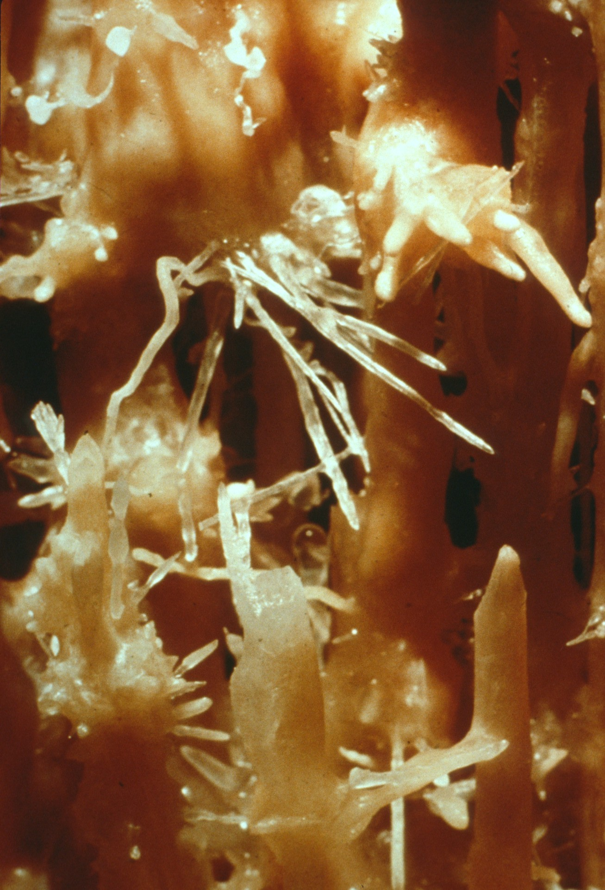
Notes:
Over the centuries the mineral deposits build up creating fantasies in stone. (Helictites in Onyx Cave, AZ, 1984 photo by Paul & Lee Stevens)

Slide 25
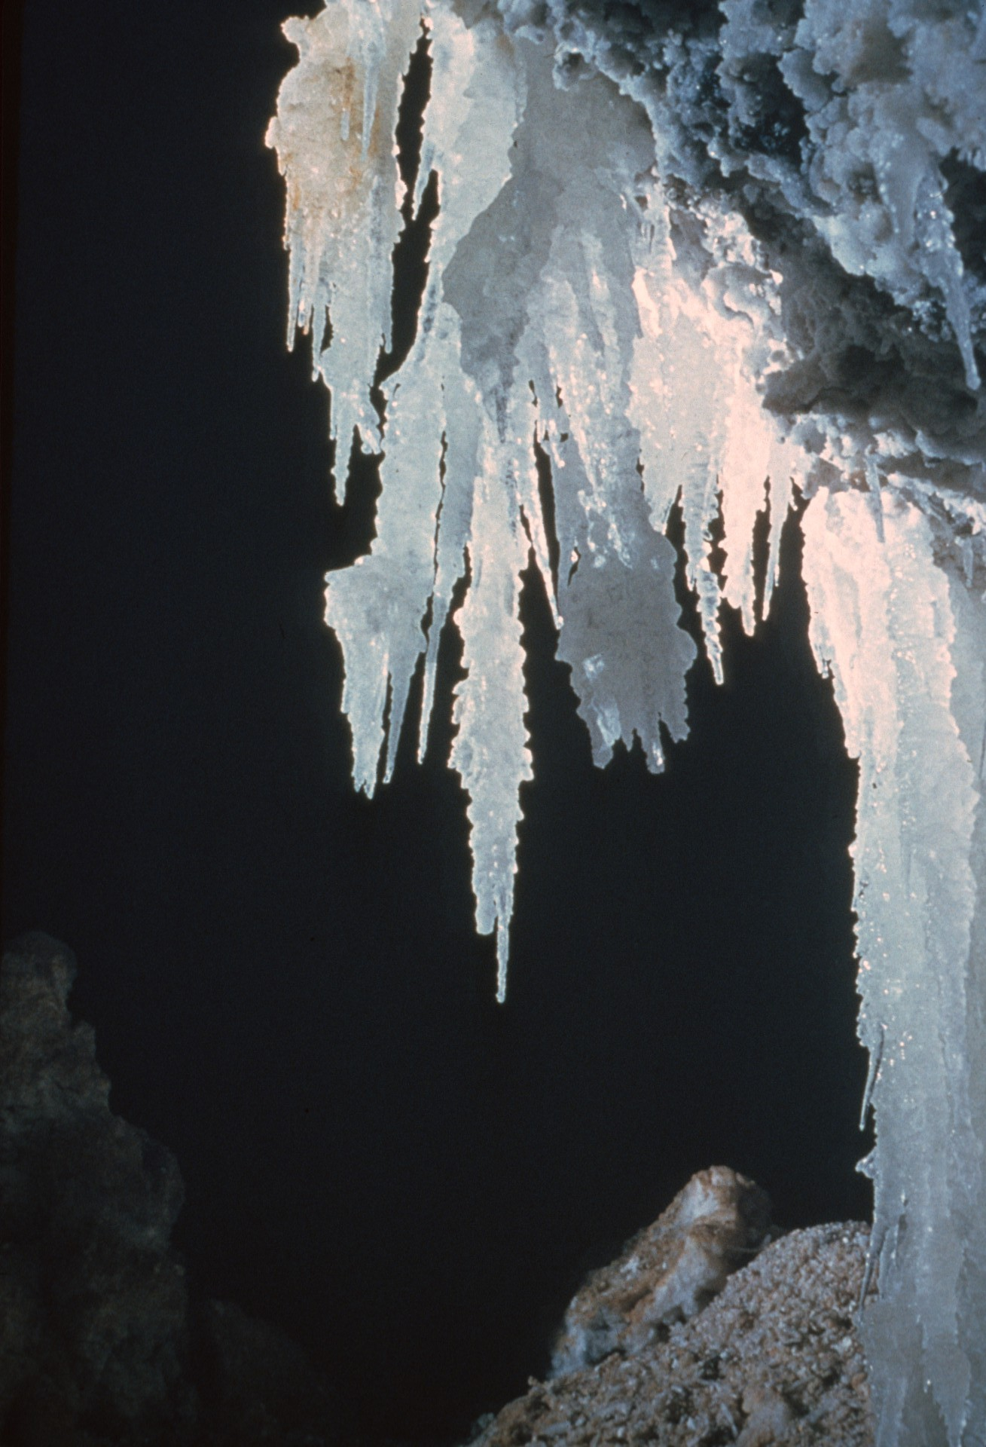
Notes:
Although these mineral formations seem solid as rock, they are actually quite very delicate. (Epsomite stalactites, Cottonwood Cave, NM, 1961 photo by Jerry Trout)

Slide 26
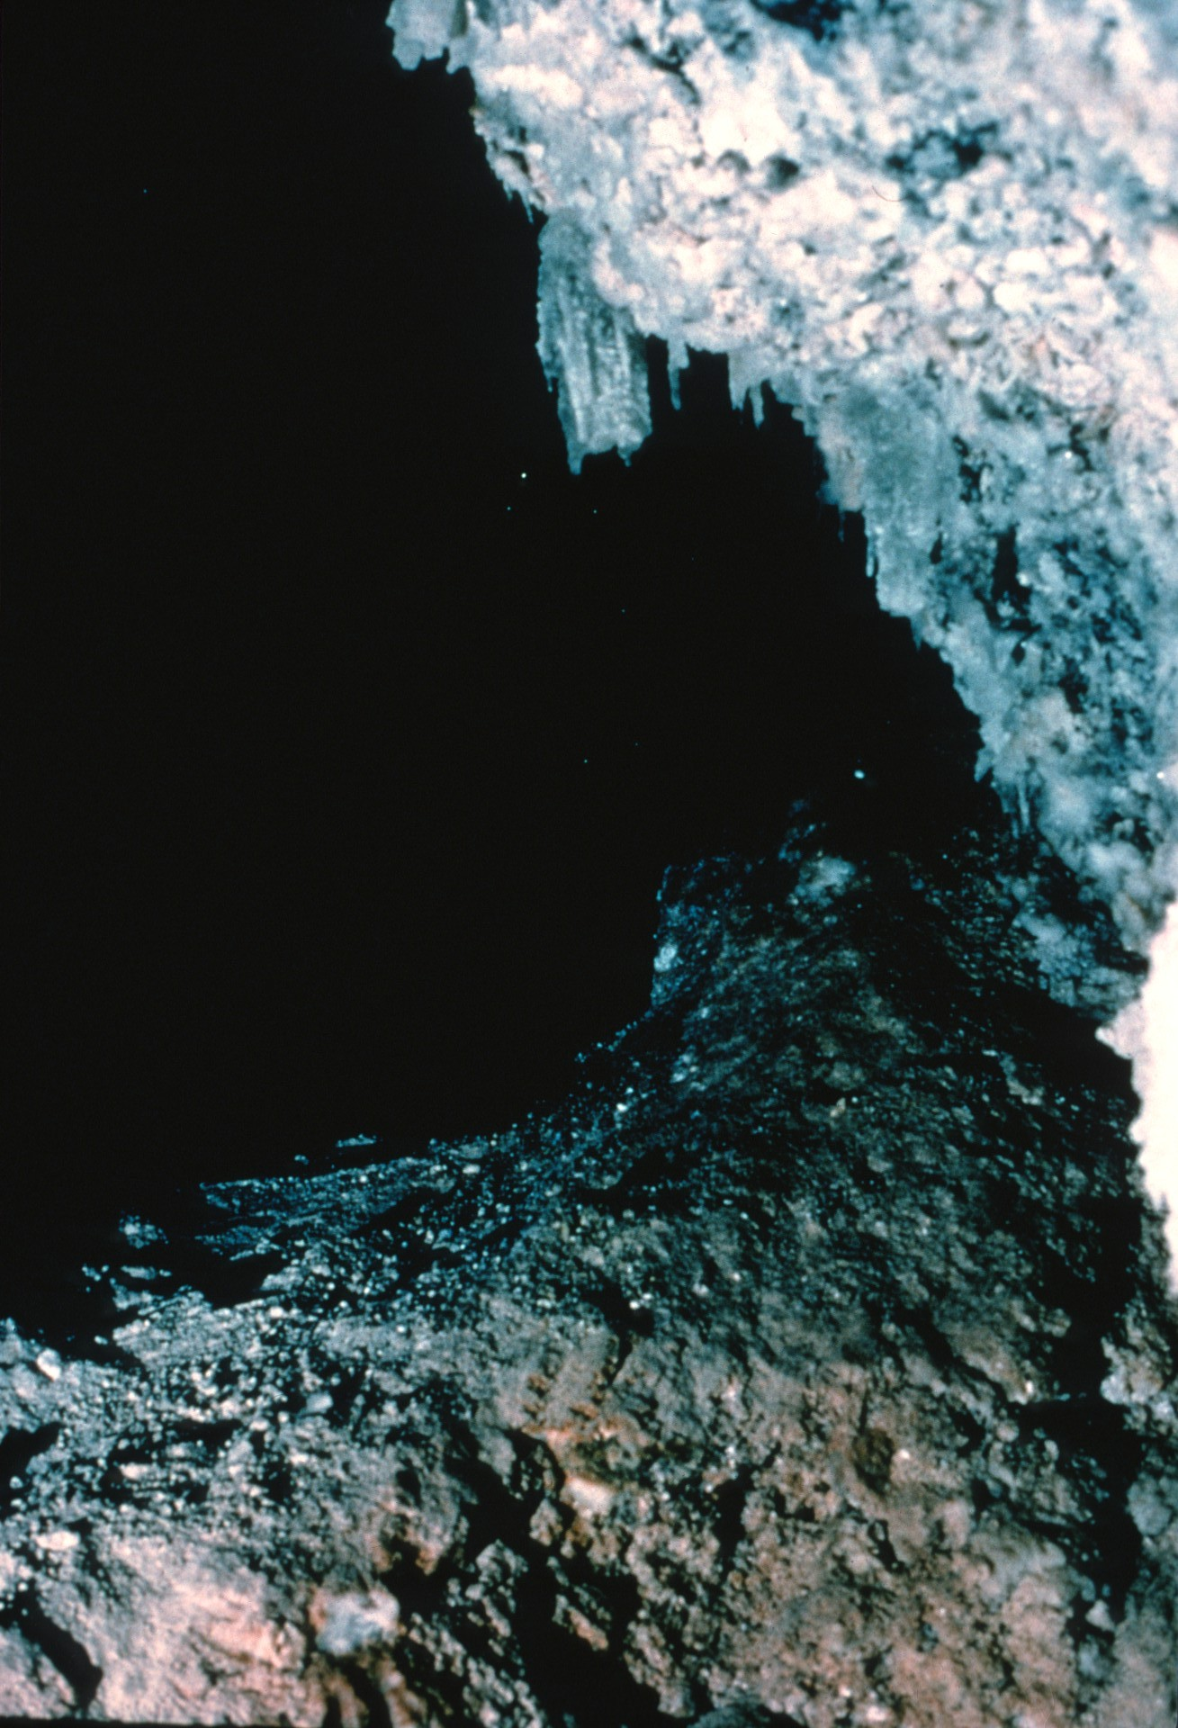
Notes:
What has taken natures centuries to create can be destroyed in seconds by carelessness and vandalism. Once destroyed, they cannot be replaced. (Epsomite stalactites after vandalism, Cottonwood Cave, NM, 196s photo by Jerry Trout)

Slide 27
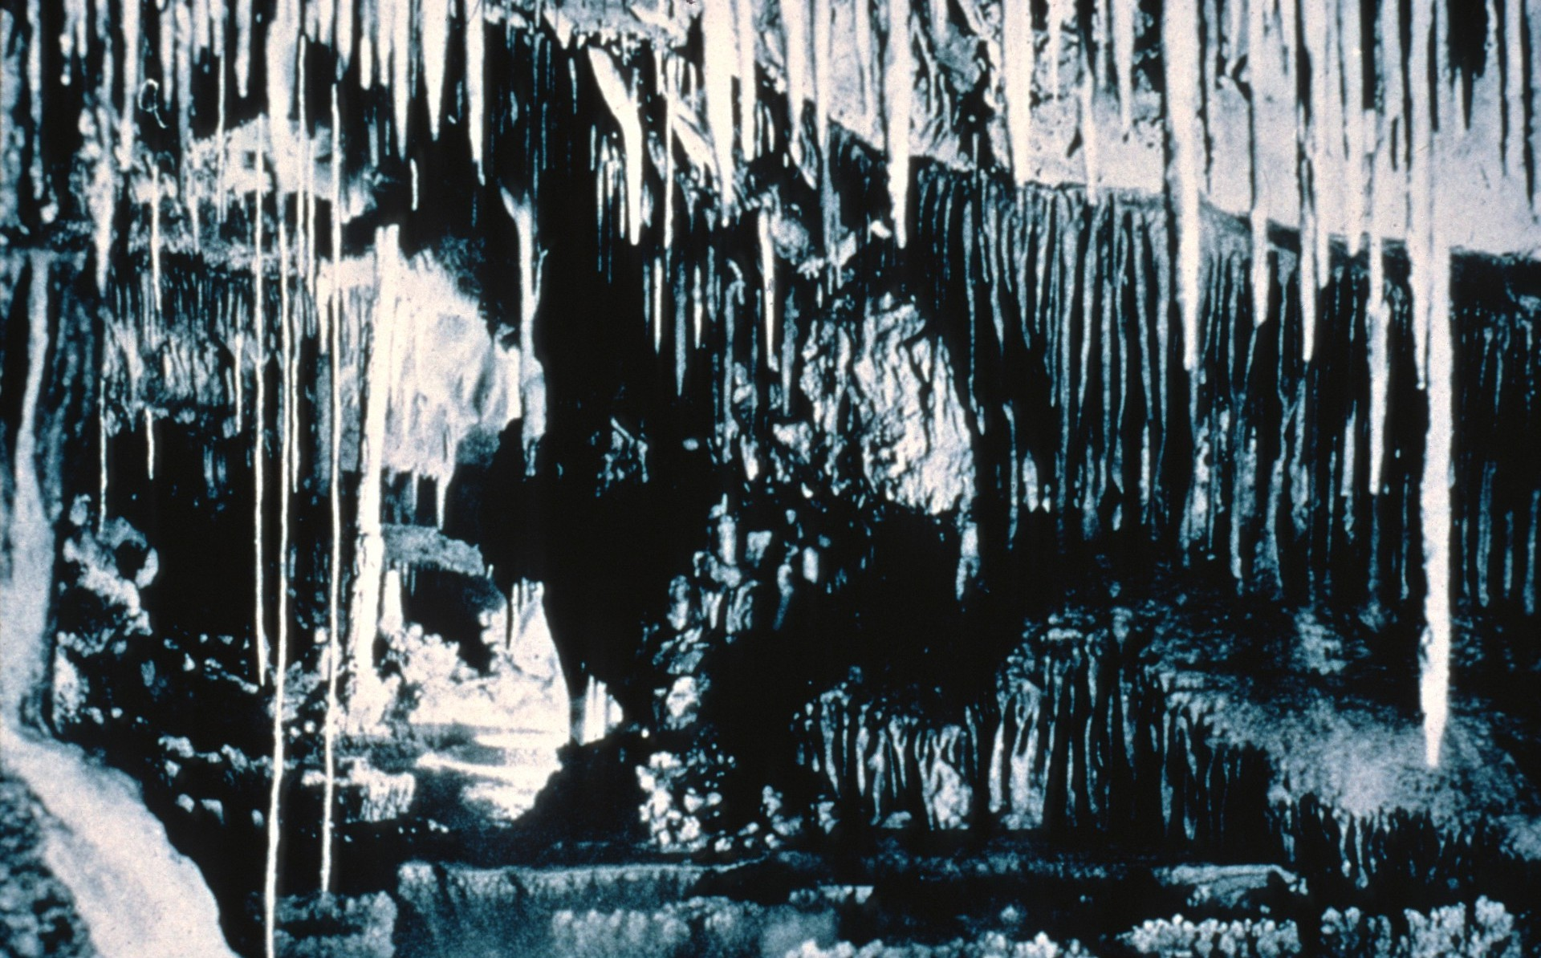
Notes:
These before-and-after pictures show how much how much has been lost… (Endless Cave, NM, 1934 photo by Bob Nymeyer)

Slide 28
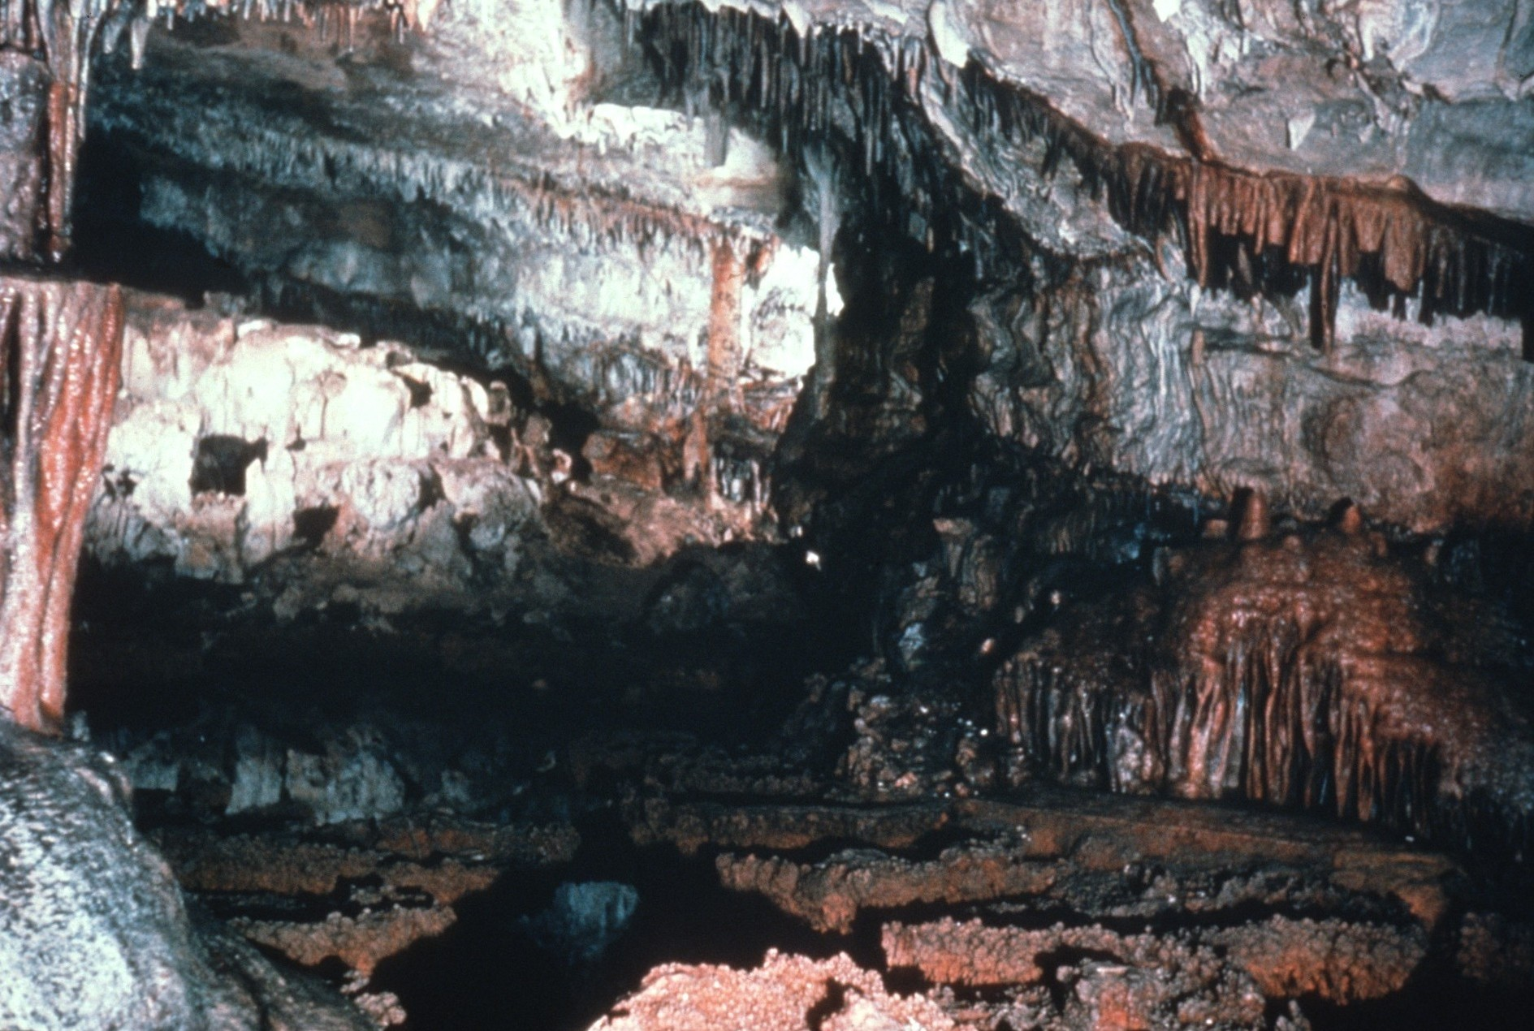
Notes:
When people deliberately or carelessly destroy the unique formations found in caves. (Endless Cave, NM, 1957 photo by Jerry Trout)

Slide 29
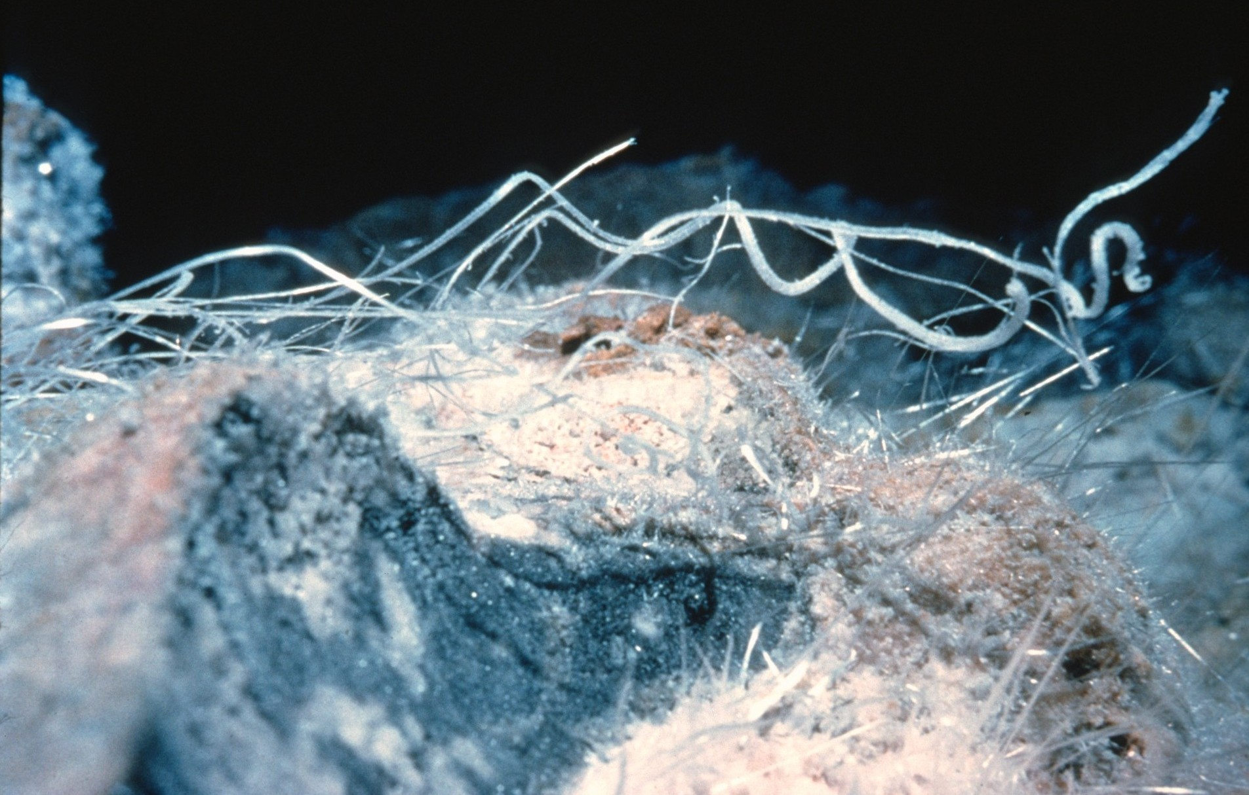
Notes:
(Gypsum rope in Cottonwood Cave, NM, 1961 photo by Jerry Trout)

Slide 30
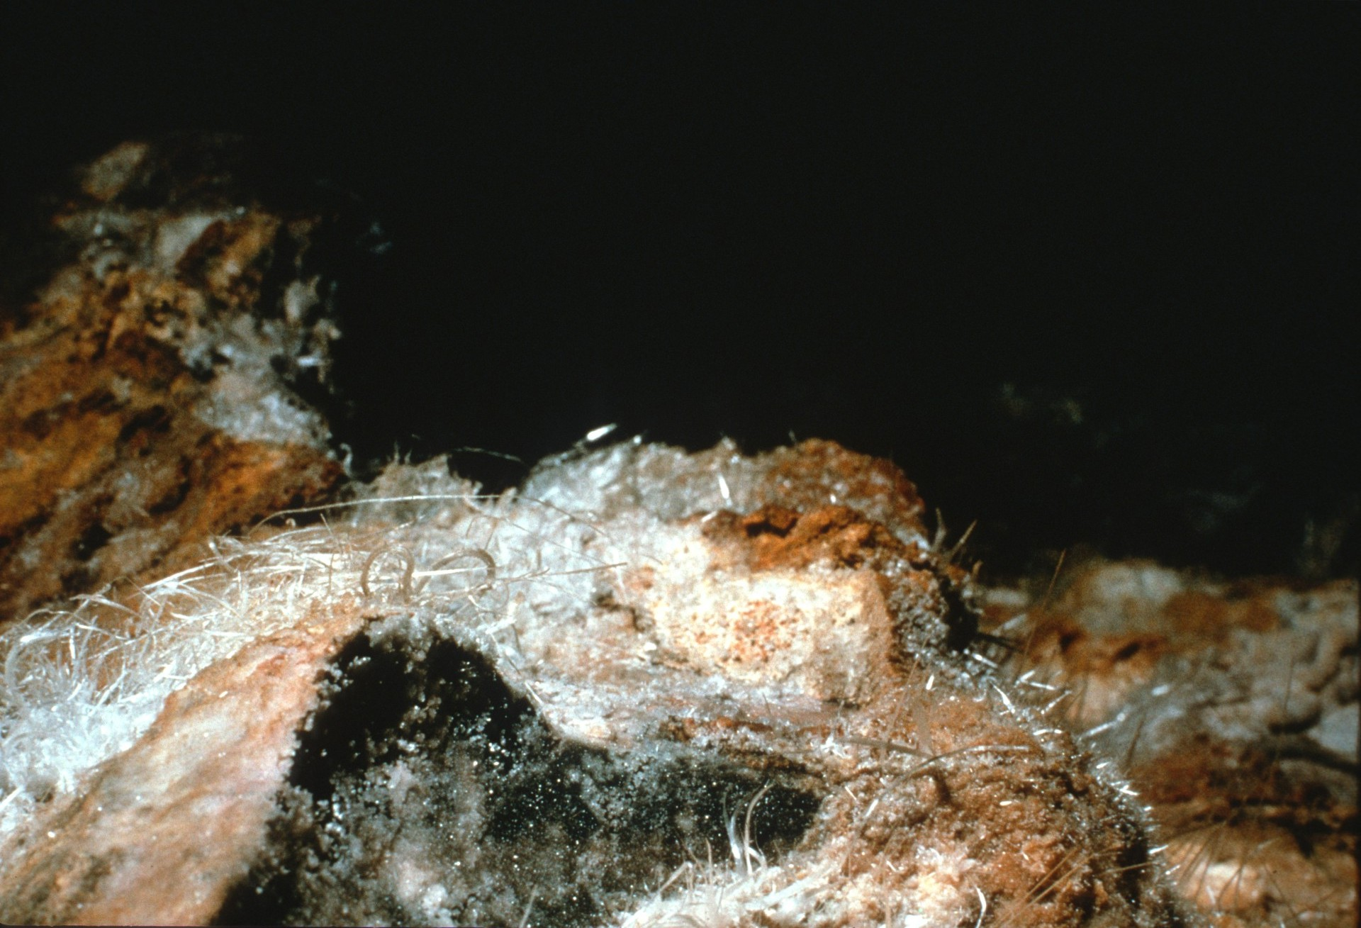
Notes:
(Gypsum rope in Cottonwood Cave after vandalism, NM, 1963 photo by Jerry Trout)

Slide 31
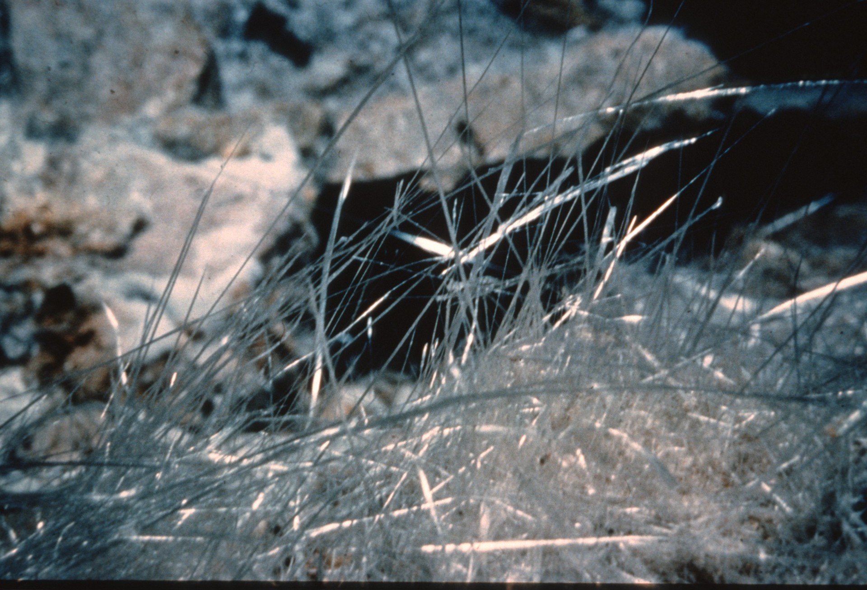
Notes:
(Selenite needles in Cottonwood Cave, NM, 1961 photo by Jerry Trout)

Slide 32
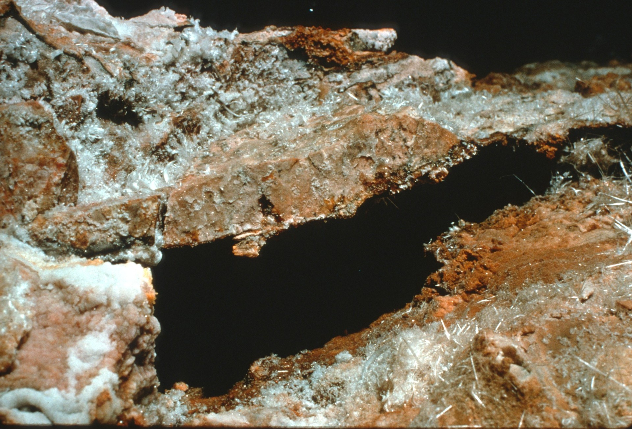
Notes:
(Selenite needles in Cottonwood Cave after vandalism, NM, 1962 photo by Jerry Trout)

Slide 33
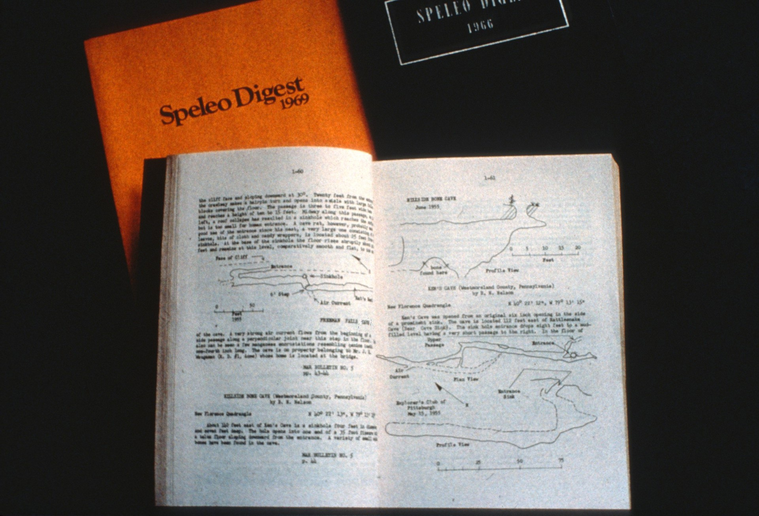
Notes:
Caves are an important source of information for those who study them. Experienced cavers frequently ensure that caves are mapped accurately and these maps are used by cave scientists who investigating cave resources.

Slide 34
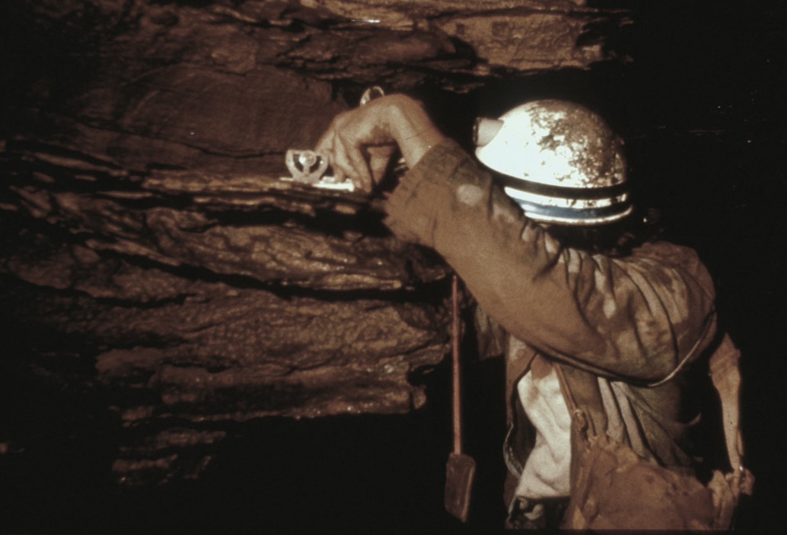
Notes:
Geologists are able to see beds of rock which might not be exposed on the surface. This has led to a much greater understanding of how the Earth was created and even provided valuable information to companies exploring for oil and gas. (Steve Stokowski measuring the dip of limestone beds in Sinnett Cave, WV, 1974 photo by Paul Stevens)

Slide 35
Notes:
Archaeologists and paleontologists have found important research sites in caves. (Patty Jo Watson and Joel Sneed examining textile in cave)

Slide 36
Notes:
Studies of people who have stayed in a cave for months have contributed greatly to an understanding of the probable effects of isolation on astronauts in space.

Slide 37
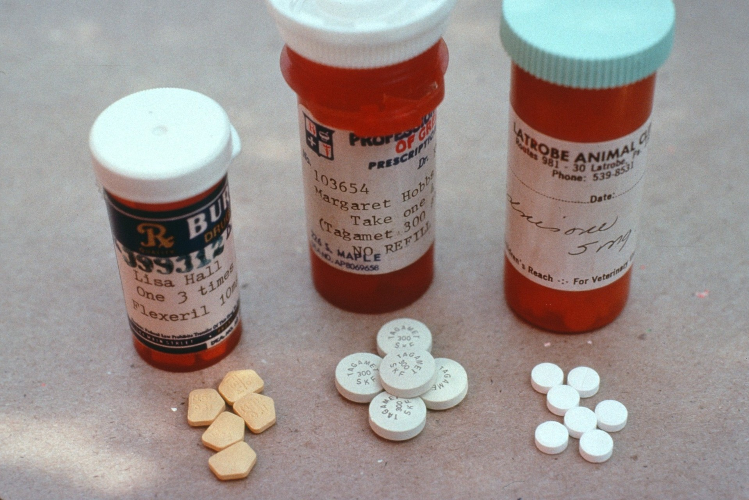
Notes:
Even the field of medicine for humans has benefitted from caves. Doctors have used a family of mold-like bacteria found in caves, called Actinomycetes to produce a wide variety of valuable antibiotics. When caves are destroyed, what other resources which could be of great value to all of us will we be losing?

Slide 38
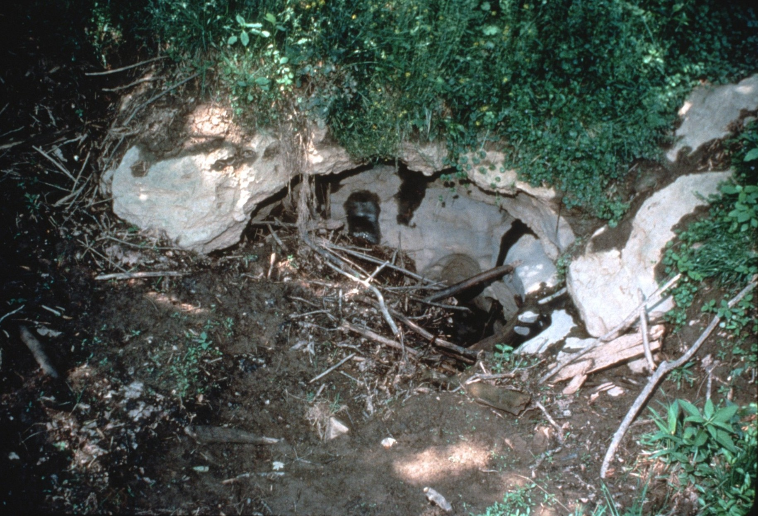
Notes:
Caves can be damaged and even destroyed by human activities. In some cases construction or timber harvesting have resulted in extensive siltation and forest debris which plugs up cave entrances and clogs underground streams. When silt gets into water in caves, the animals which depend on clean water die. (Silt and debris at Sively’s #3 entrance to Organ Cave, WV. 1978 photo by Paul & Lee Stevens)

Slide 39
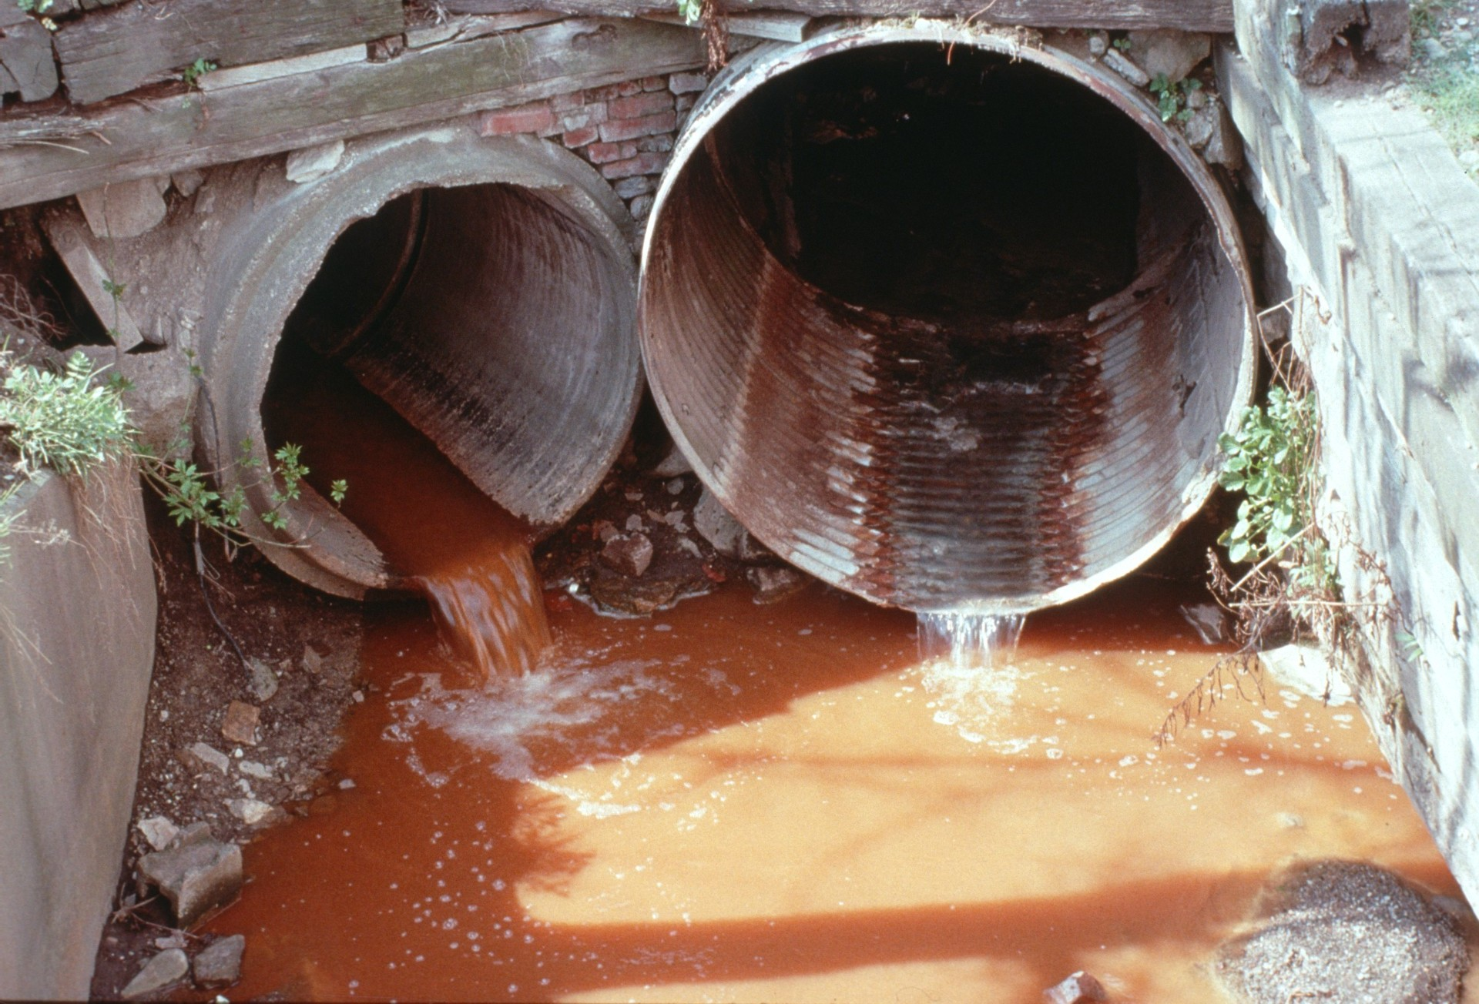
Notes:
Fertilizer and pesticides spread on fields, leaking sewage pipes, and spills of oil gasoline, or other toxic substances can also affect caves. Like water, these liquids move through cracks in the ground. These have been known to cause “bad air” in caves, where no animal, including humans, can survive. Eventually these pollutants reach an underground stream or contaminate the ground water.

Slide 40
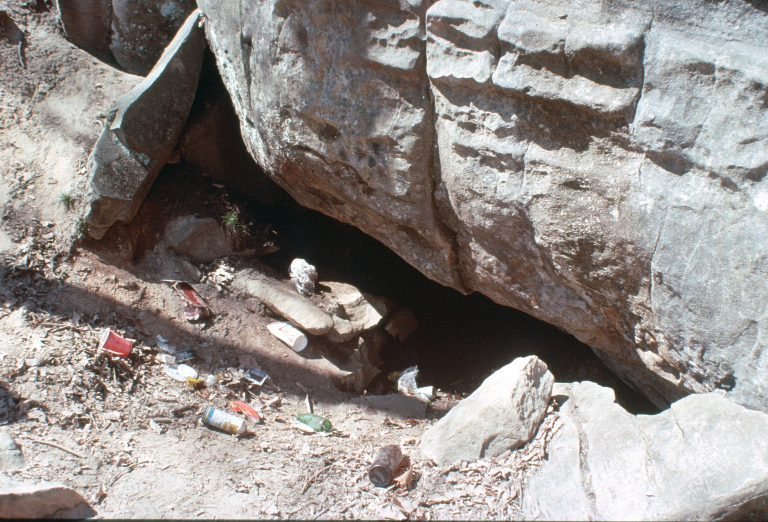
Notes:
The destruction of caves does not have to continue if people realize what an important natural resource they are.

Slide 41
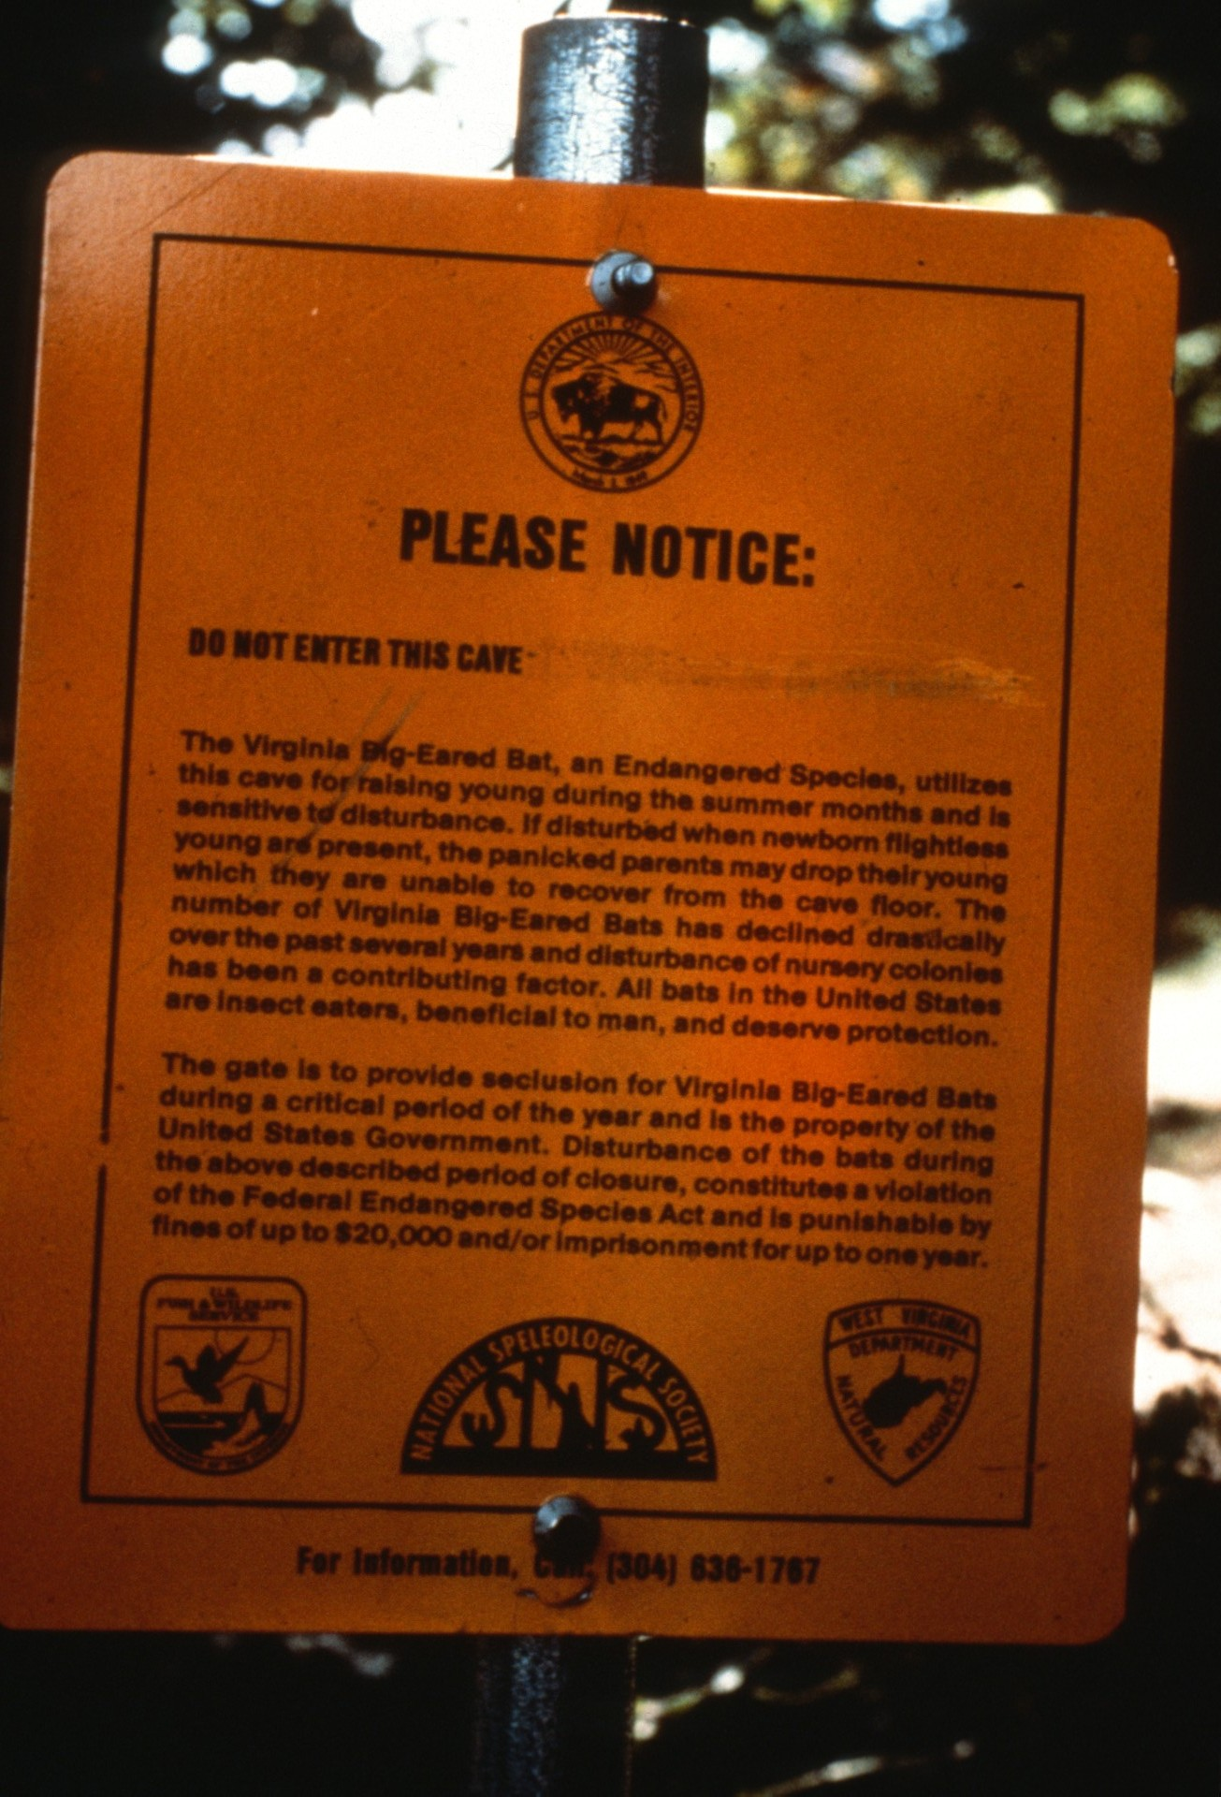
Notes:
Some caves are being protected because they are an important habitats for endangered species. (Sinnett Cave protection sign, WV. 1983 photo by Paul Stevens)

Slide 42
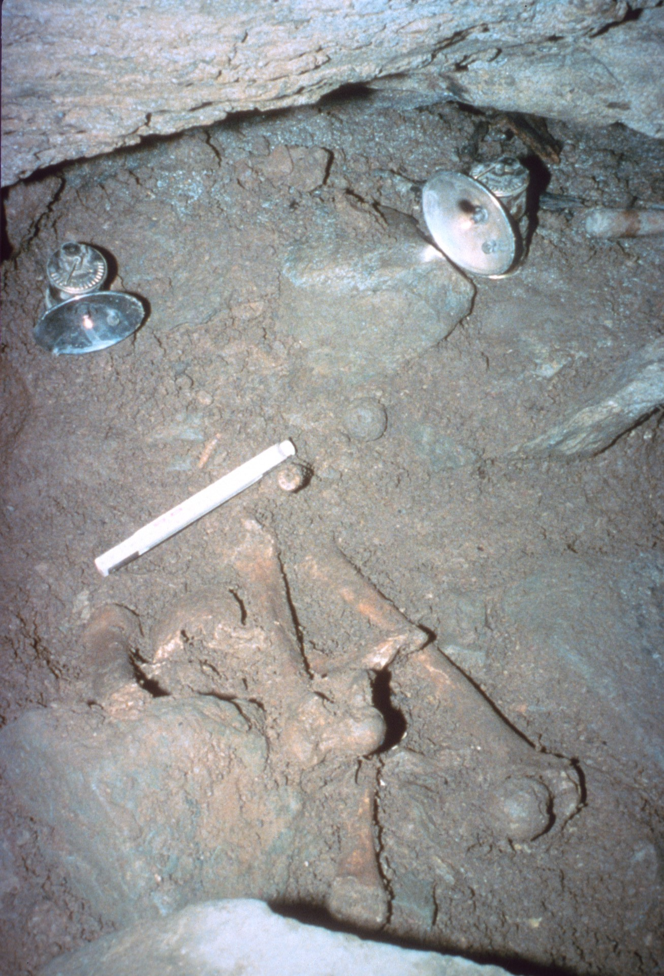
Notes:
Other caves are being watched carefully because of important archaeological or paleontological sites they contain.

Slide 43
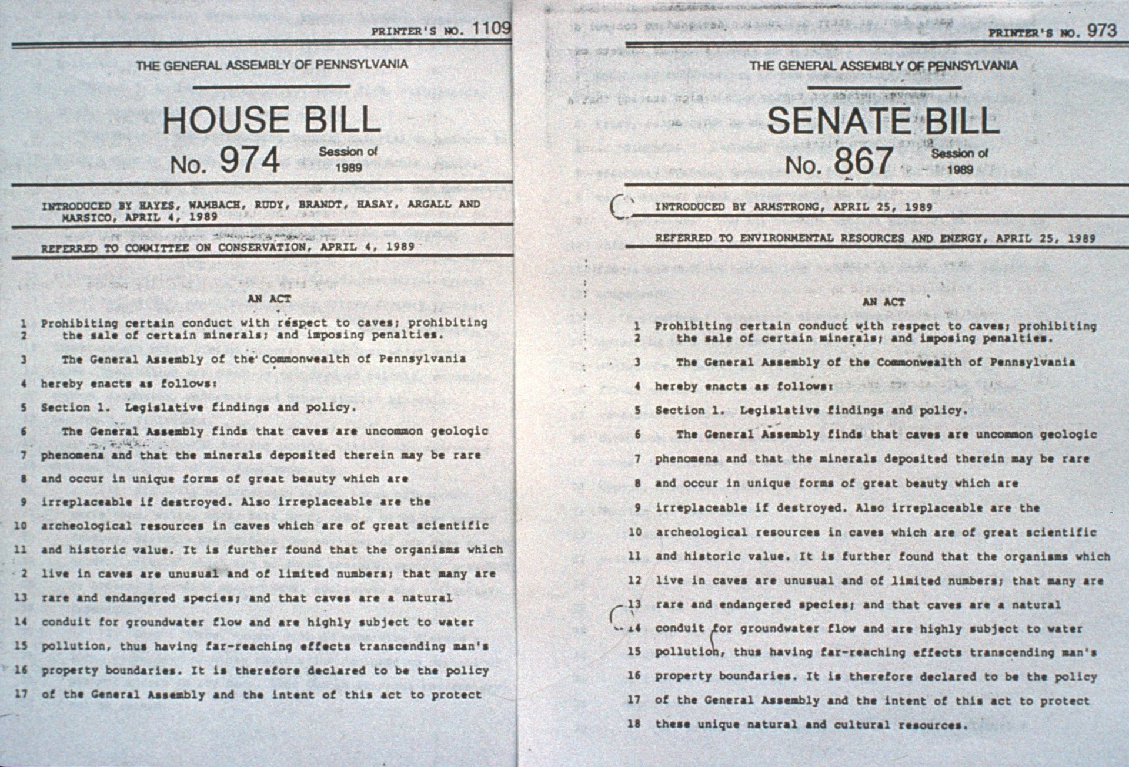
Notes:
Almost half the states in the country have already passed cave protection laws which make it illegal for people to harm animals or destroy minerals and formations in caves. In 1988 the U. S. Congress passed the Federal Cave Resources Protection Act which requires agency land managers to consider any cave resources on federal lands which might be damaged by surface activities.

Slide 44
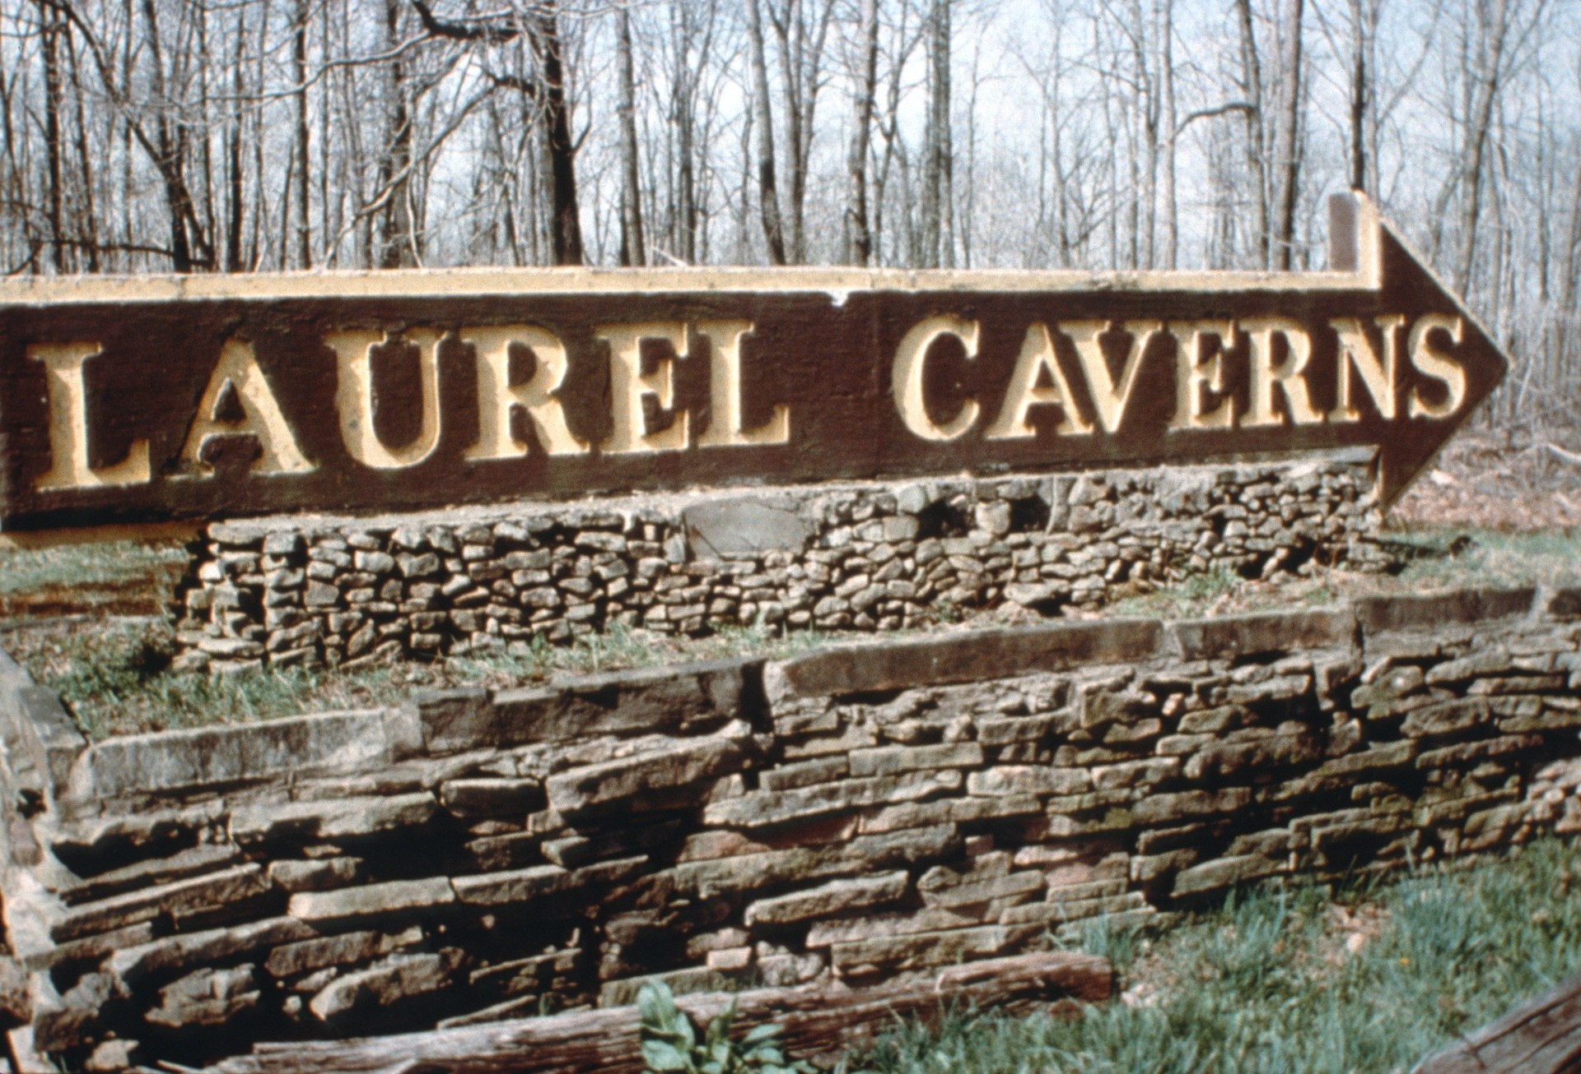
Notes:
Millions of people each year visit caves to experience for themselves the unique environment which caves contain. The tourist dollars these people generate are essential income for many communities.

Slide 45
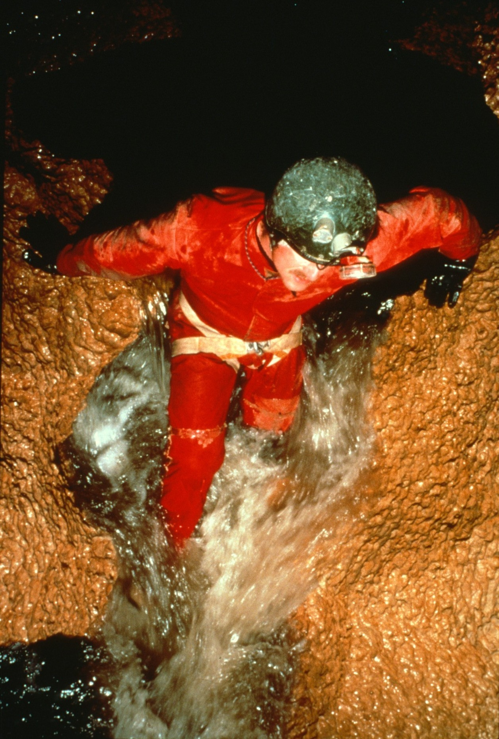
Notes:
People who visit wild caves realize they will be attempting a strenuous activity which requires special knowledge, skills, and clothing. (Photo by Ron Simmons)

Slide 46
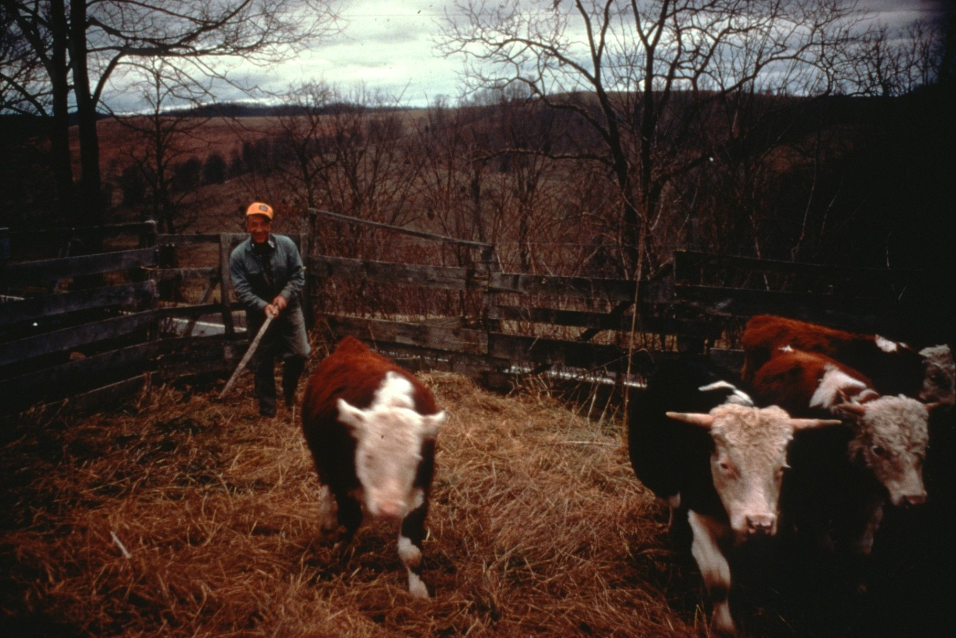
Notes:
Anyone who wants to go into a wild cave should be sure to go with experienced cavers. The rights of the land owner must be respected and cavers must be careful to obtain permission before entering a cave. If the owner has decided to close a cave for all or part of the year for any reason, their wish should be respected. Only in this way will land owners come to trust cavers as responsible visitors and be willing to open access to their caves. (George Sively, owner of Organ Cave, WV. 1974 photo by Paul Stevens)

Slide 47
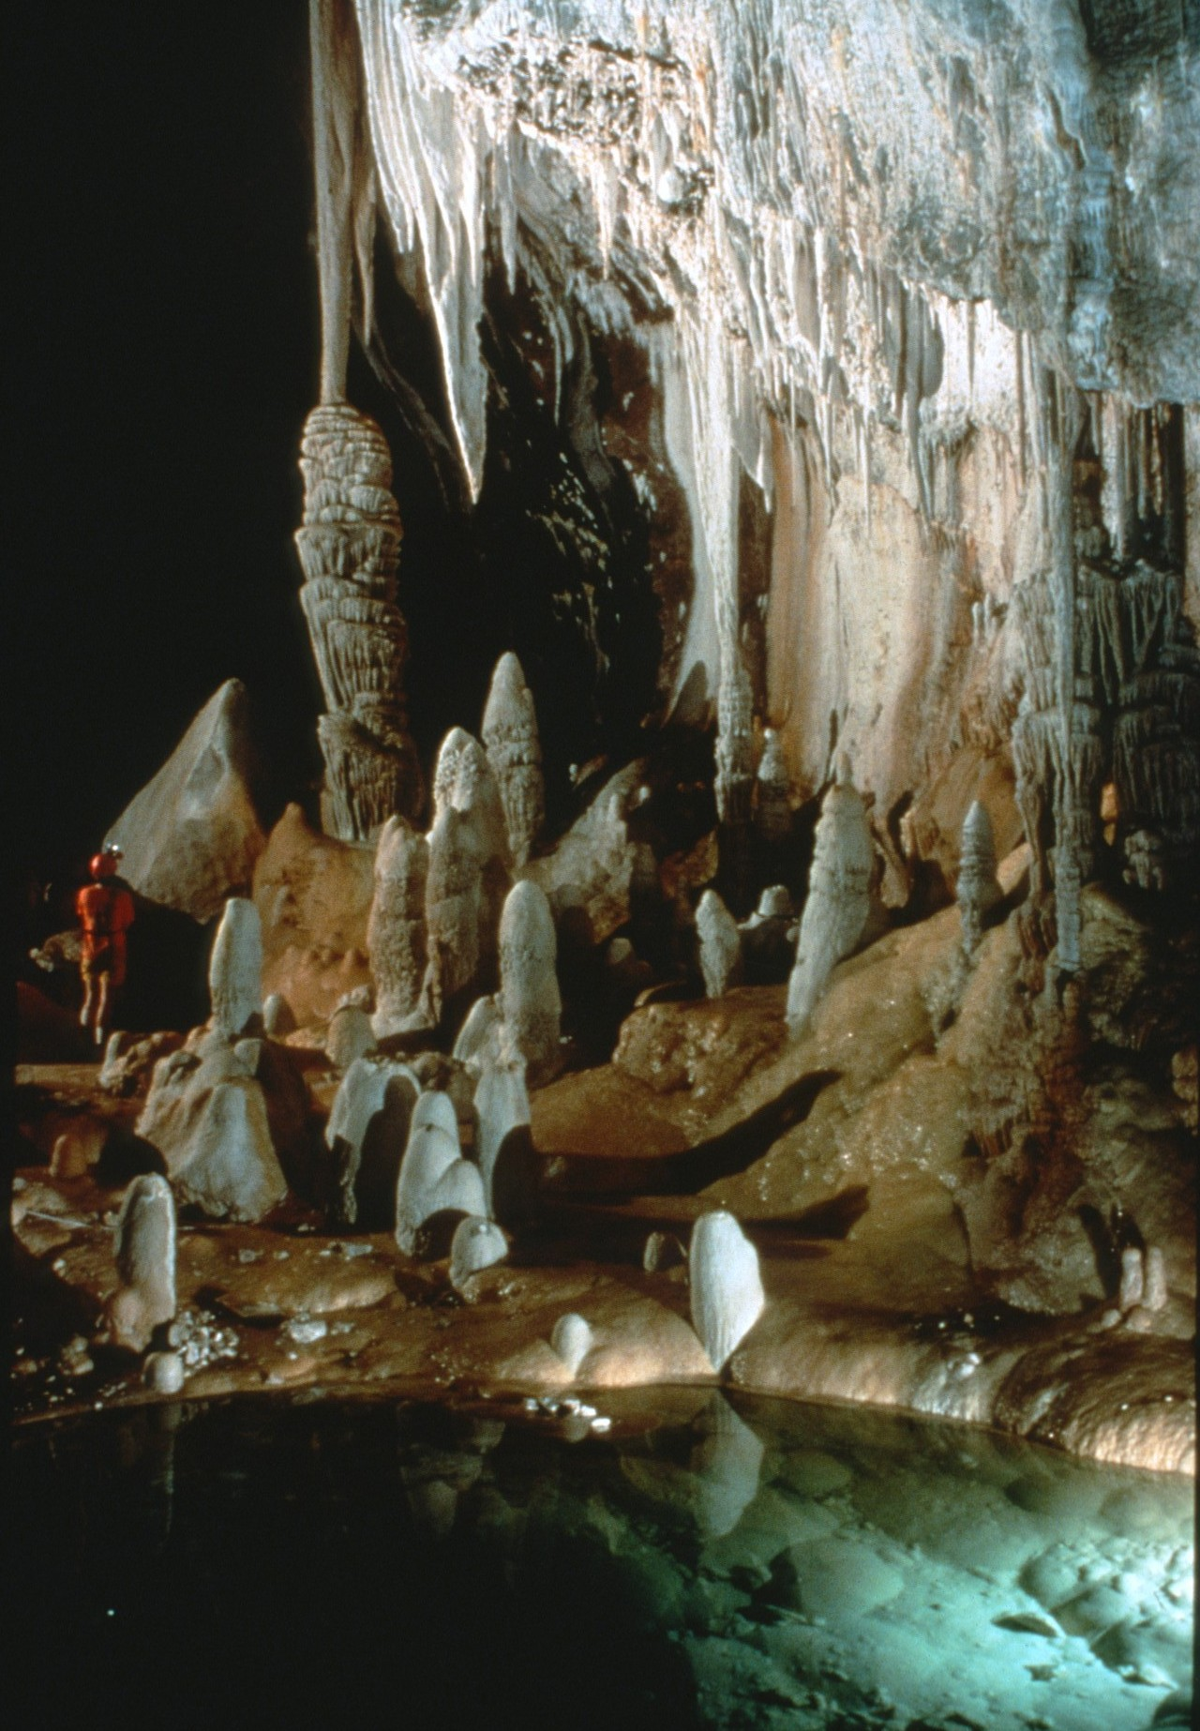
Notes:
Once inside the cave experienced cavers remember that they are visitors to an alien world. (Lechuguilla Cave, NM. Photo by Dave Bunnell)

Slide 48
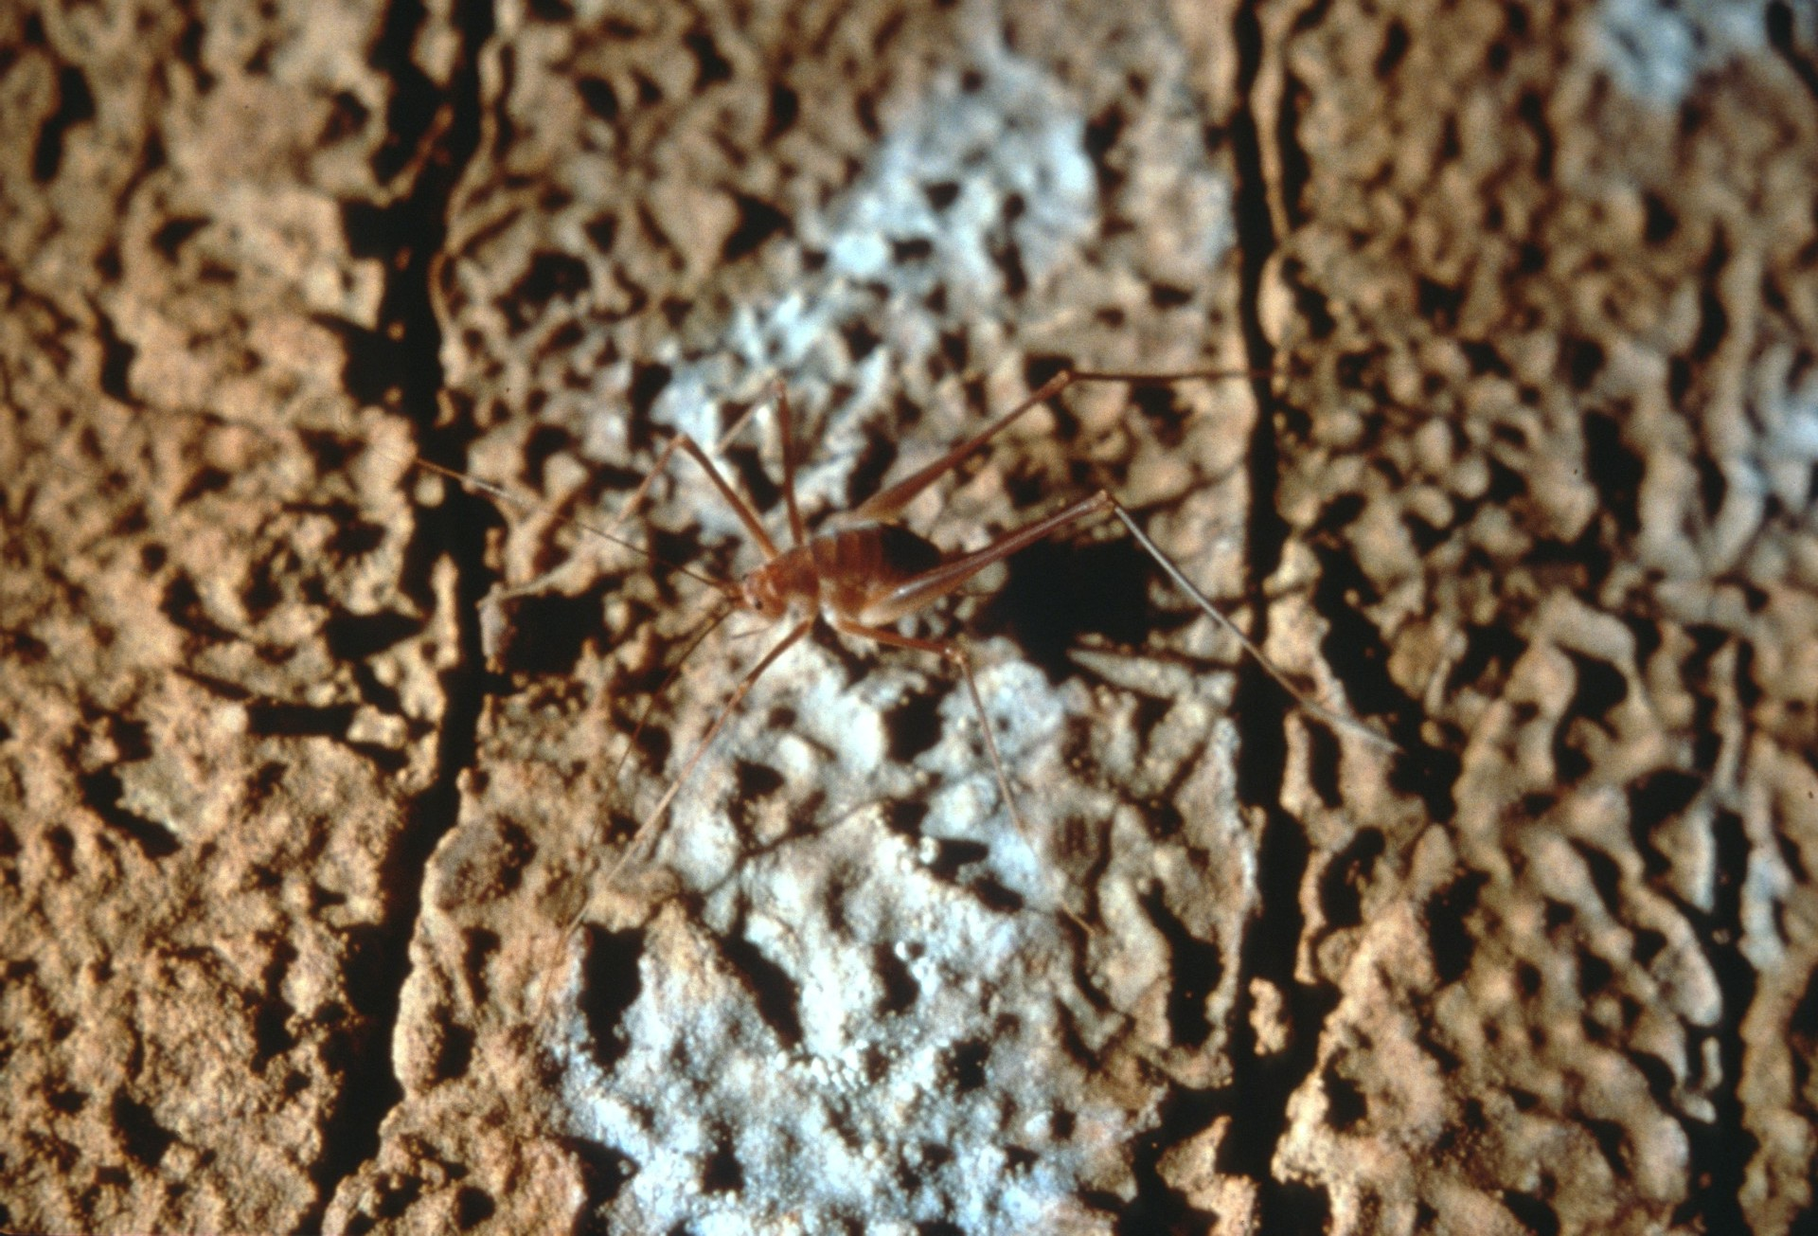
Notes:
Cave animals depend on an unpolluted cave to survive. (Photo by Horton Hobbs, III)

Slide 49
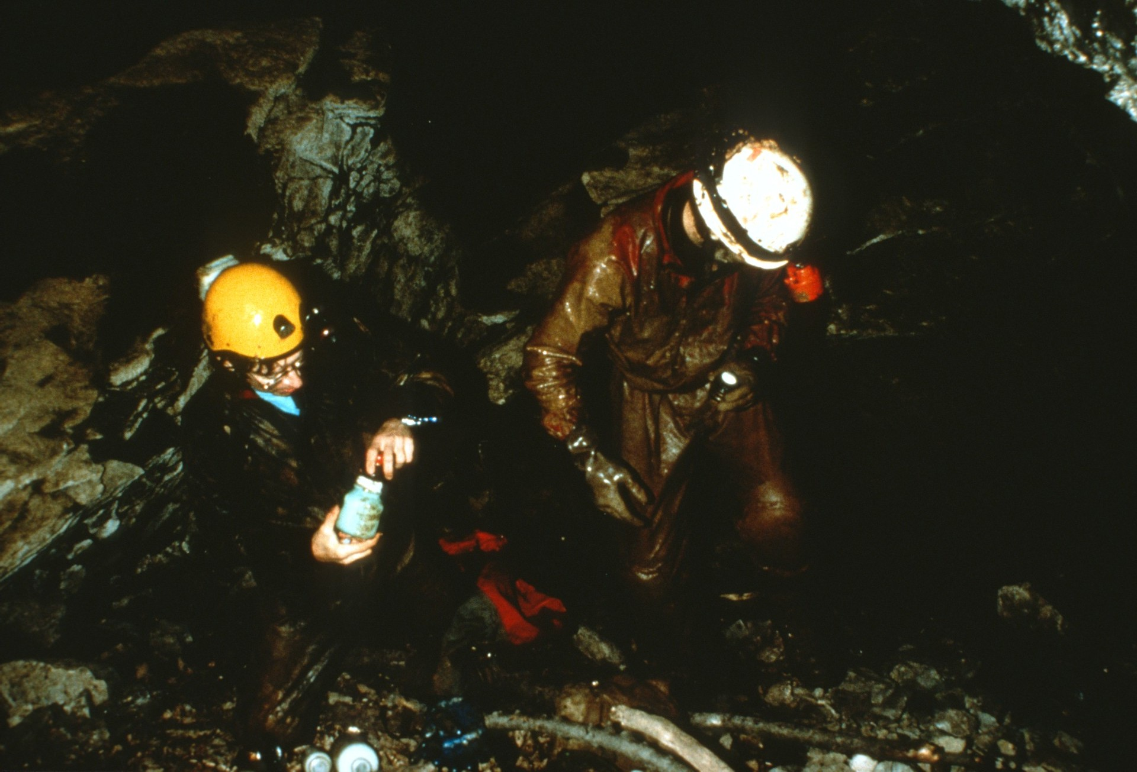
Notes:
To try to keep caves from becoming polluted, many cavers remove trash they find which has been left by thoughtless visitors.

Slide 50
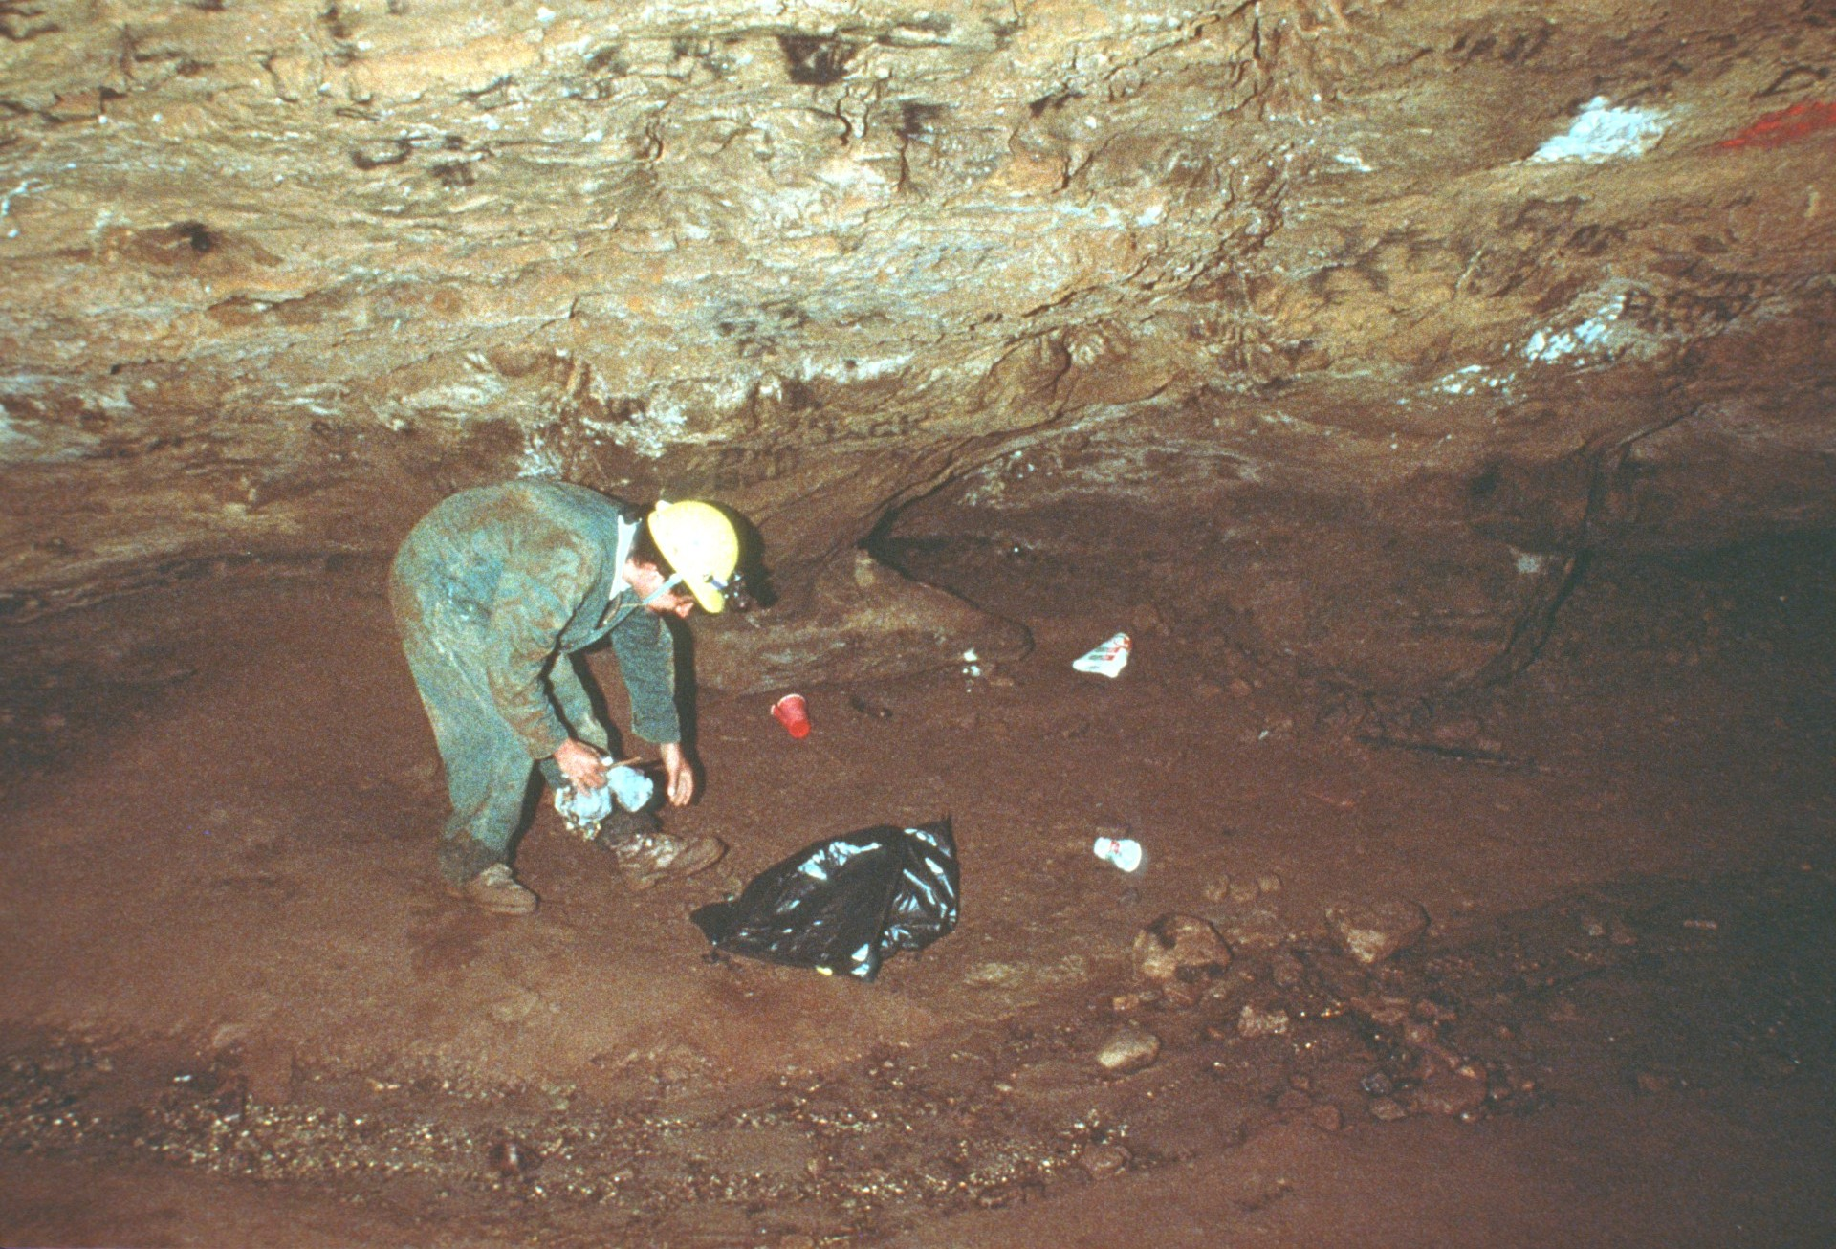
Notes:
Many cavers take plastic bags into the cave so they can remove from the cave anything they have taken into it.

Slide 51
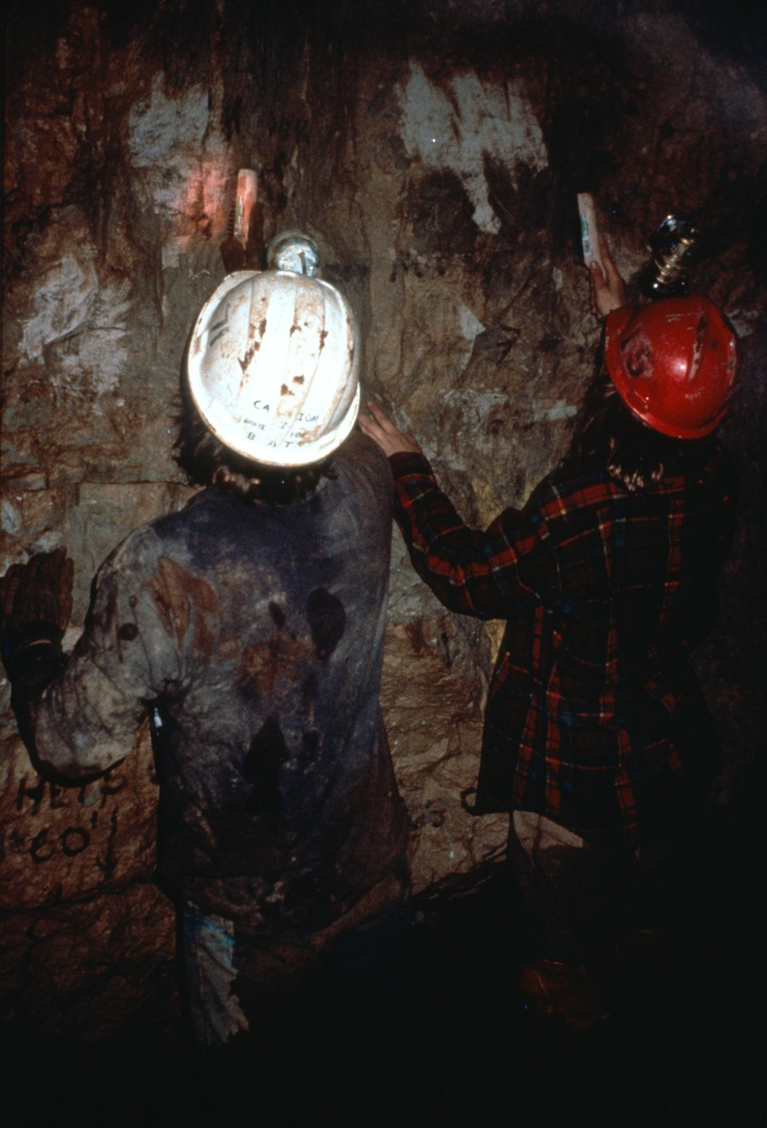
Notes:
Some cavers take brushes and plastic bottles of water into the cave so they can help to remove any signs of vandalism.

Slide 52
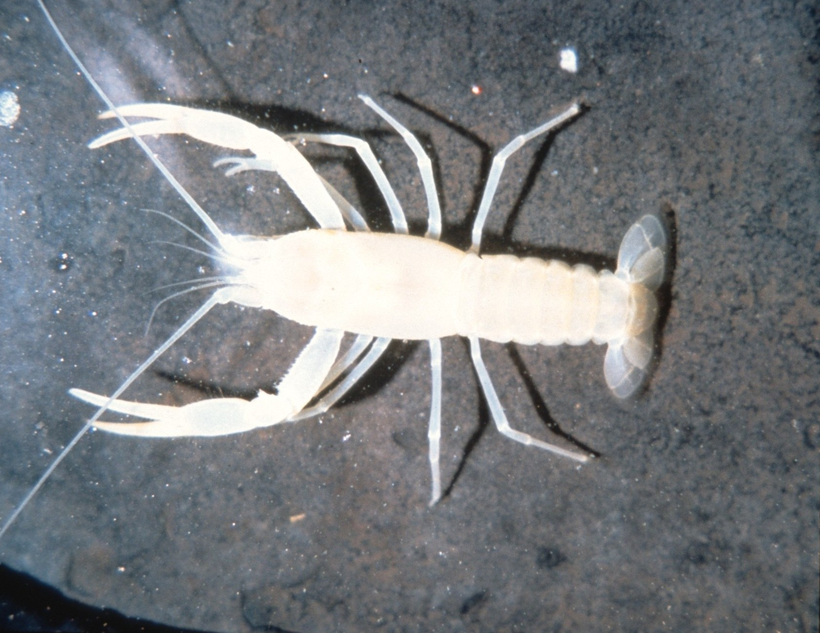
Notes:
Whenever cavers find cave animals they are careful not to disturb them. (Crayfish photo by Horton Hobbs, III)

Slide 53
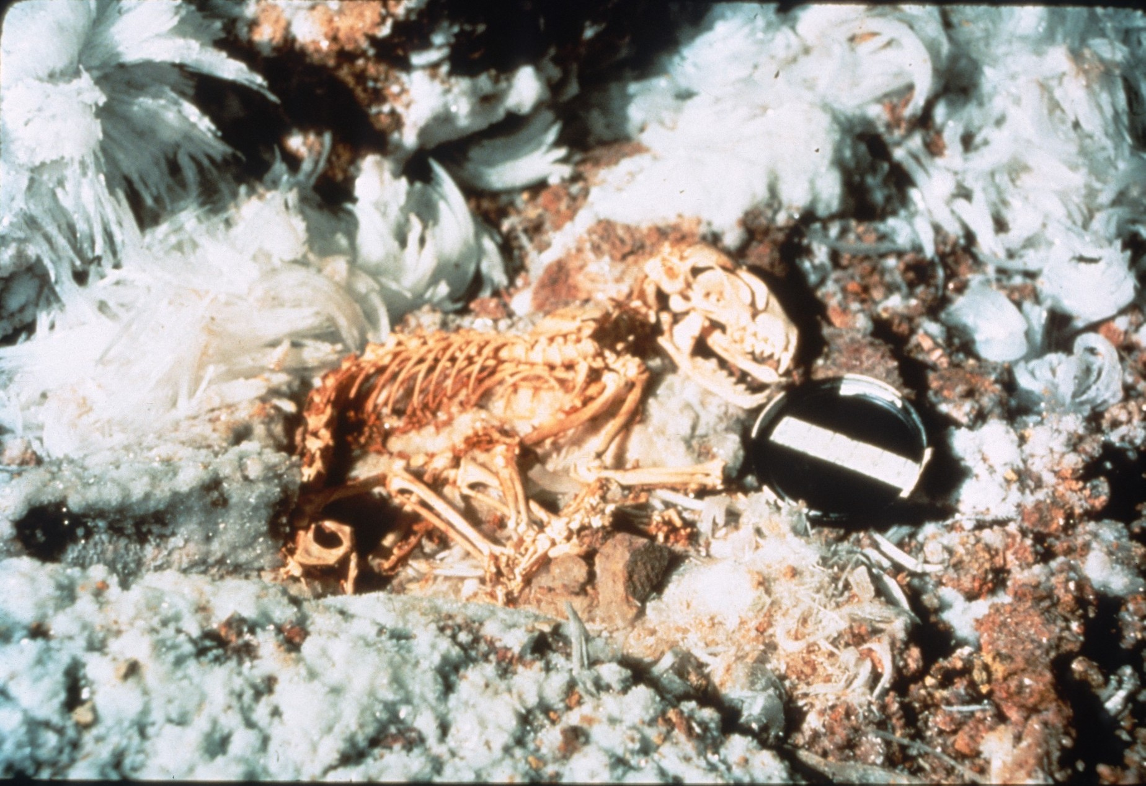
Notes:
When experienced cavers find ancient artifacts or prehistoric animal bones, they leave them undisturbed. Instead of removing the object, they report their find to qualified scientists who are best able to obtain the maximum amount of information from the discovery. (Photo by Tom Strong and Lousie Hose)

Slide 54
Notes:
In areas of caves where there are many mineral formations experienced cavers take extreme care to avoid touching and damaging them. Even the oils from a person’s hands can soil a formation and halt its natural growth process. (Arizona cave, 1984 photo by Paul Stevens)

Slide 55
Notes:
The National Speleological Society urges anyone visiting a cave to “take nothing but pictures, leave nothing but footprints, kill nothing but time.” Only in this way will the animals which depend on caves for their existence be able to survive. Only in this way will the delicate formations survive to be enjoyed by others.

Slide 56
Notes:
The National Speleological Society is committed to protecting caves. People who go caving and even those who do not visit wild caves can do their part to work with us and help protect these unique resources. (Ann Bosted looking at an aragonite bush in Lechuguilla Cave, NM. Photo by Peter and Ann Bosted)

Slide 57
Notes:
If you live in a state which does not have a cave protection law, let your legislators know you think one should be enacted. (Pennsylvania State Capitol)

Slide 58
Notes:
Where cave protection laws exists we are able to prosecute vandals who destroy resources important to all of us.

Slide 59
Notes:
Help to ensure that pollution is removed from streams, rivers, and groundwater.

Slide 60
Notes:
Help us to obtain laws which would forbid the commercial sale of cave formations in any state. (Rock Shop, Horse Cave, KY, photo by Paul and Lee Stevens)

Slide 61
Notes:
Only in this way will we be able to protect the unique resources which are found in caves and ensure that they remain for the enjoyment of future generations. (Djuna Bewley in Lechuguilla Cave, NM. Photo by Norman Thompson)

Slide 62
Production by:
Lisa Hall
Janet Thorne
Paul Stevens

Slide 63
Photographs by:
Peter & Ann Bostsed
Dave Bunnell
Chip Clark
Rick Day
Lisa Hall
Horton Hobbs, III
Karen & Ernst Kastning
Ed McCarthy & Carl Samples
Charles E. Mohr
Bob Nymeyer
Ron Simmons
Joel Sneed
Paul & Lee Stevens
William Storage
Tom Strong & Louise Hose
Norm Thompson
Gary Trout

Slide 64
An NSS Audio-Visual Library Presentation
Caves:
A Unique and Fragile Environment
Original slide program S205
Script by Janet Thorne
Artwork by Mark Jackson and Ernst Kastning
Original text slides by Barry Chute
Slides digitized by David Caudle
PowerPoint program created by Jim McConkey
64 slides, with script in presenter notes
PowerPoint created 1/25/2021
National Speleological Society
6001 Pulaski Pike
Huntsville, AL 35810-1122
256- 852-1300
nss@caves.org
https://caves.org/

